Slide 1
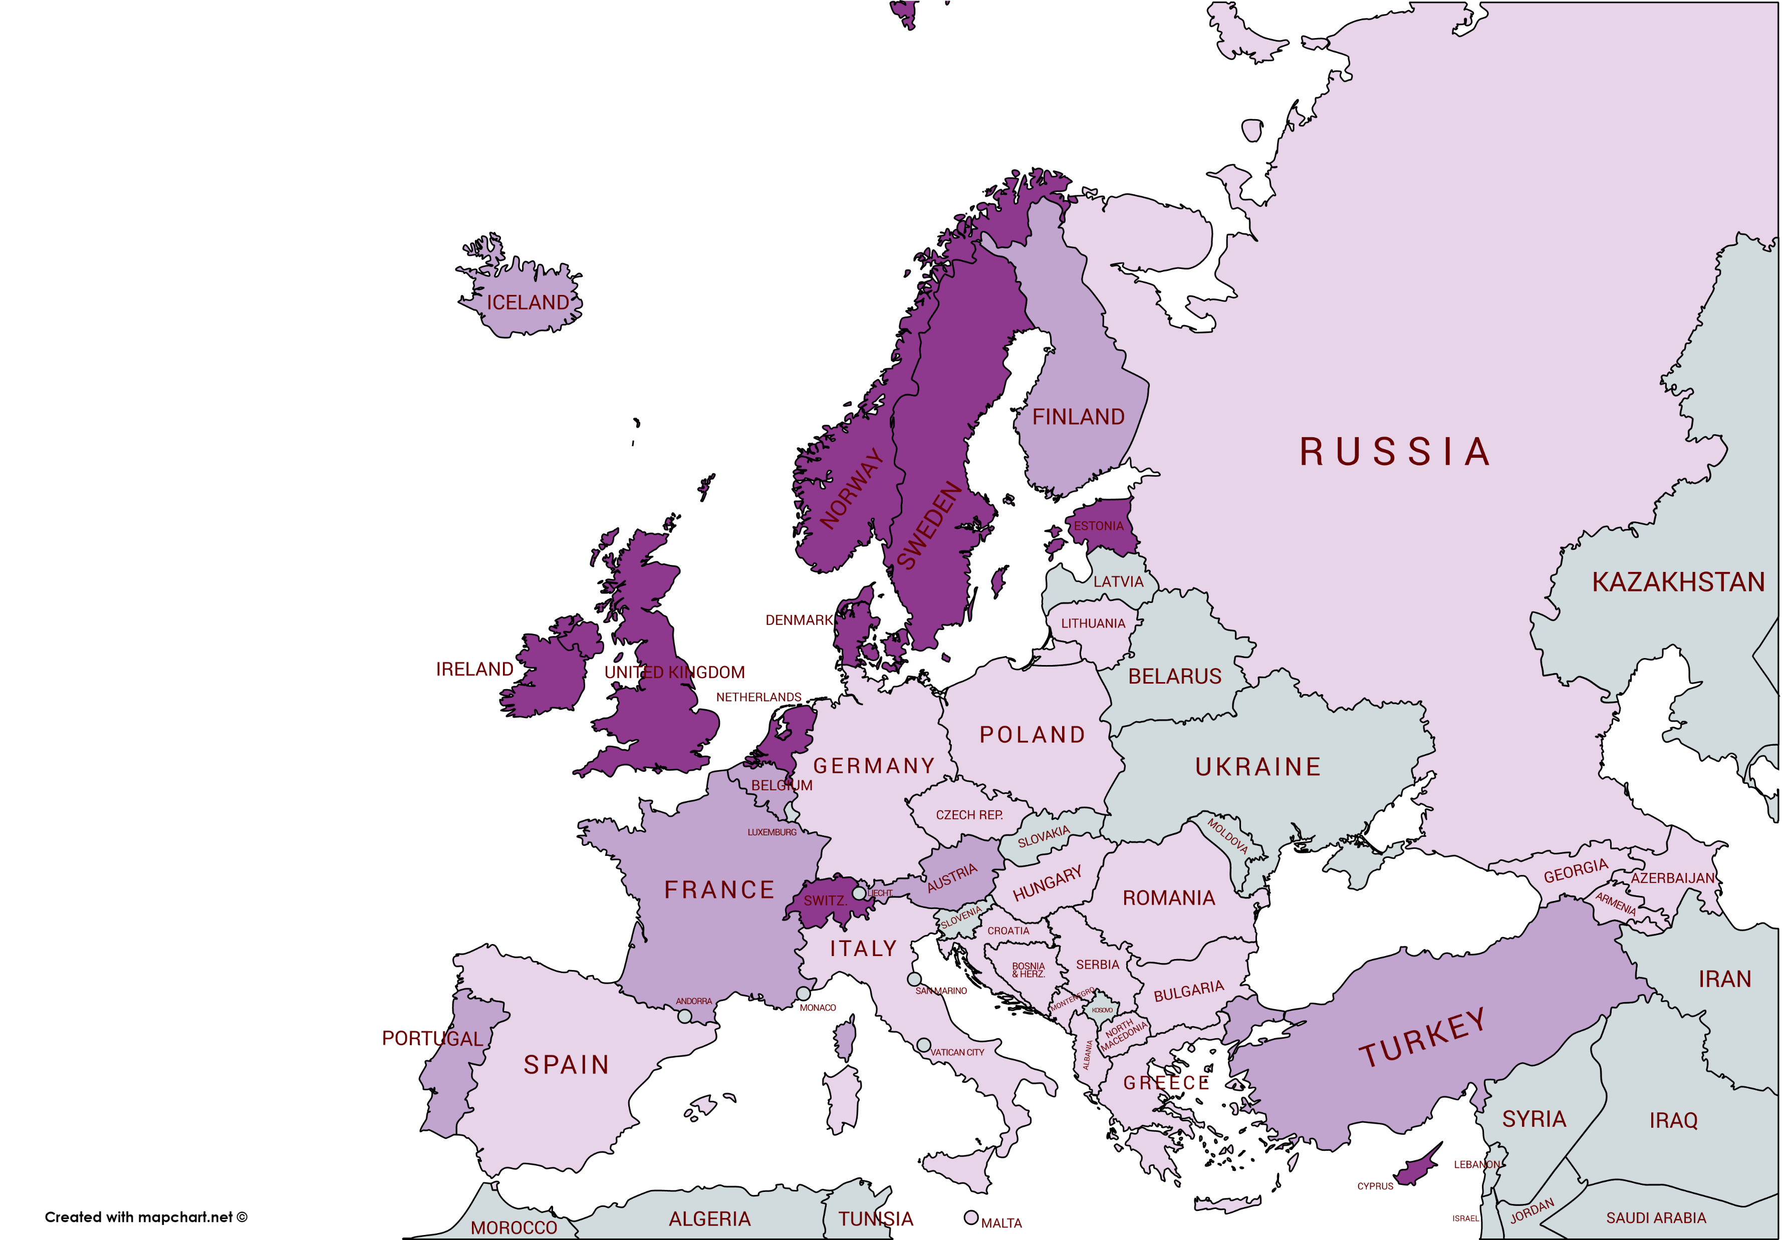

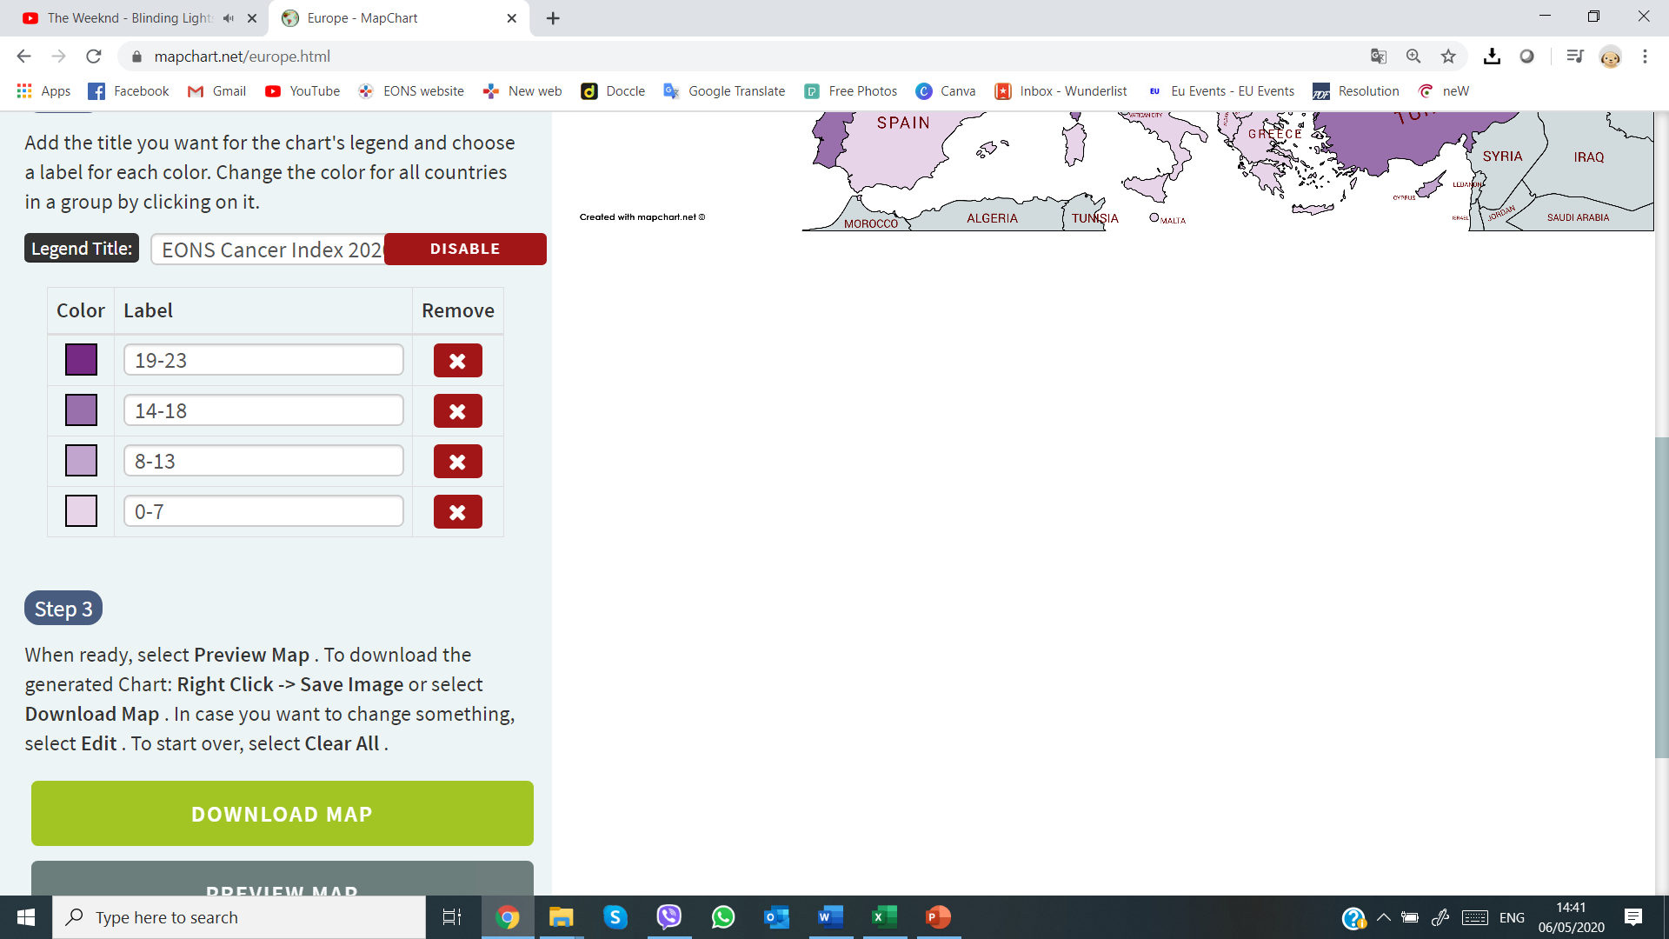
EONS Cancer Nursing Index 2020
Education and Career Development
Scoring System:
#ΕCND20Go4EQUALITY
All rights reserved from
EONS Advocacy Working Group© 2020
Find out more: www.cancernurse.eu
PALESTINE

Slide 2
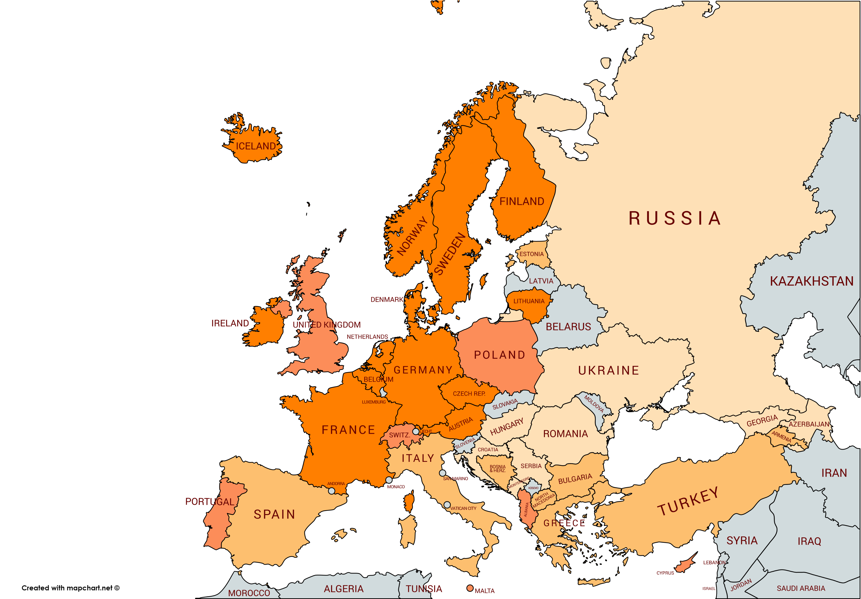
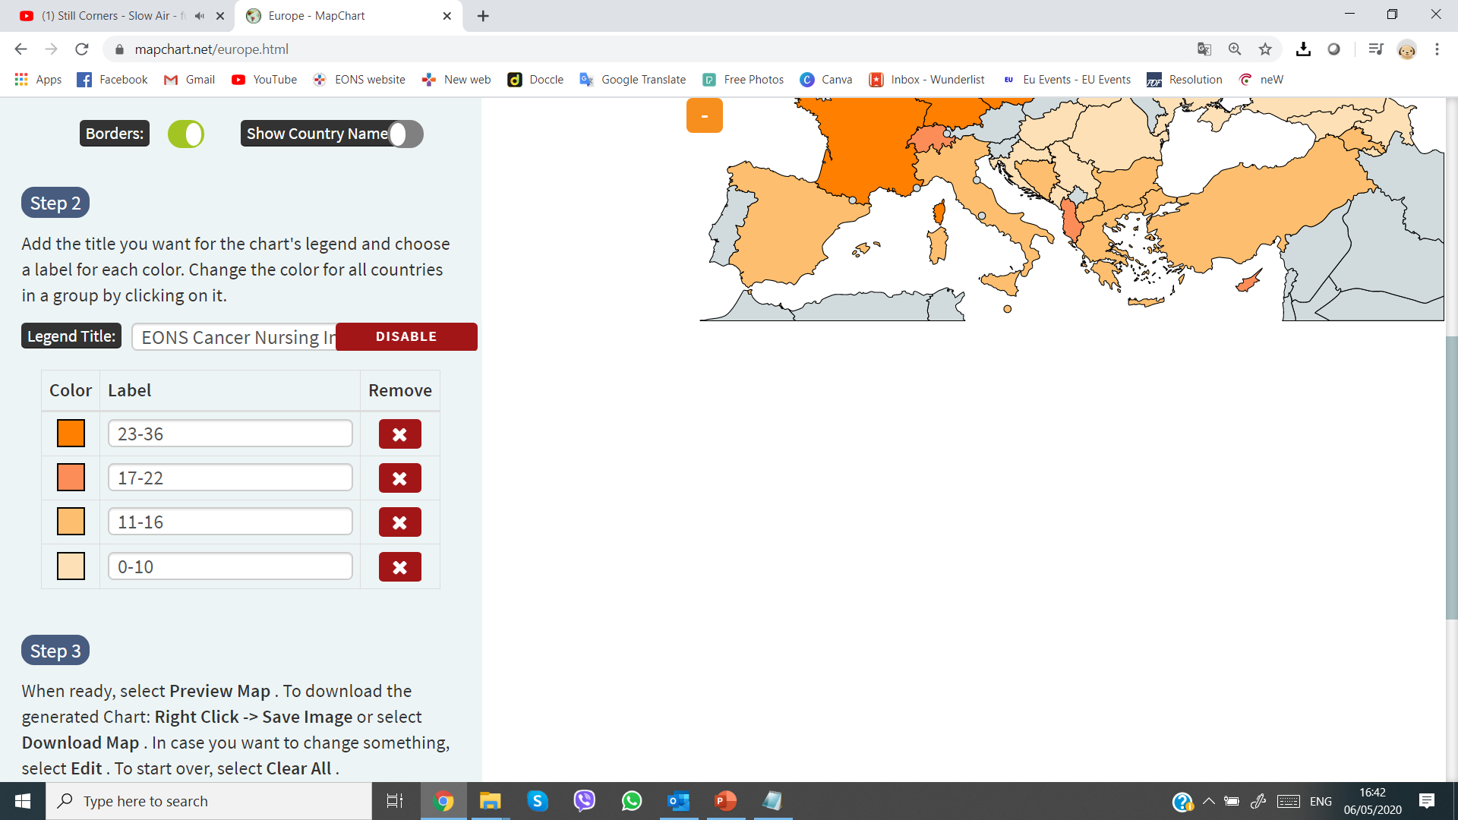
EONS Cancer Nursing Index 2020
Patient and Occupational Safety
Scoring System:
#ΕCND20Go4EQUALITY
All rights reserved from
EONS Advocacy Working Group© 2020
Find out more: www.cancernurse.eu
PALESTINE

Slide 3
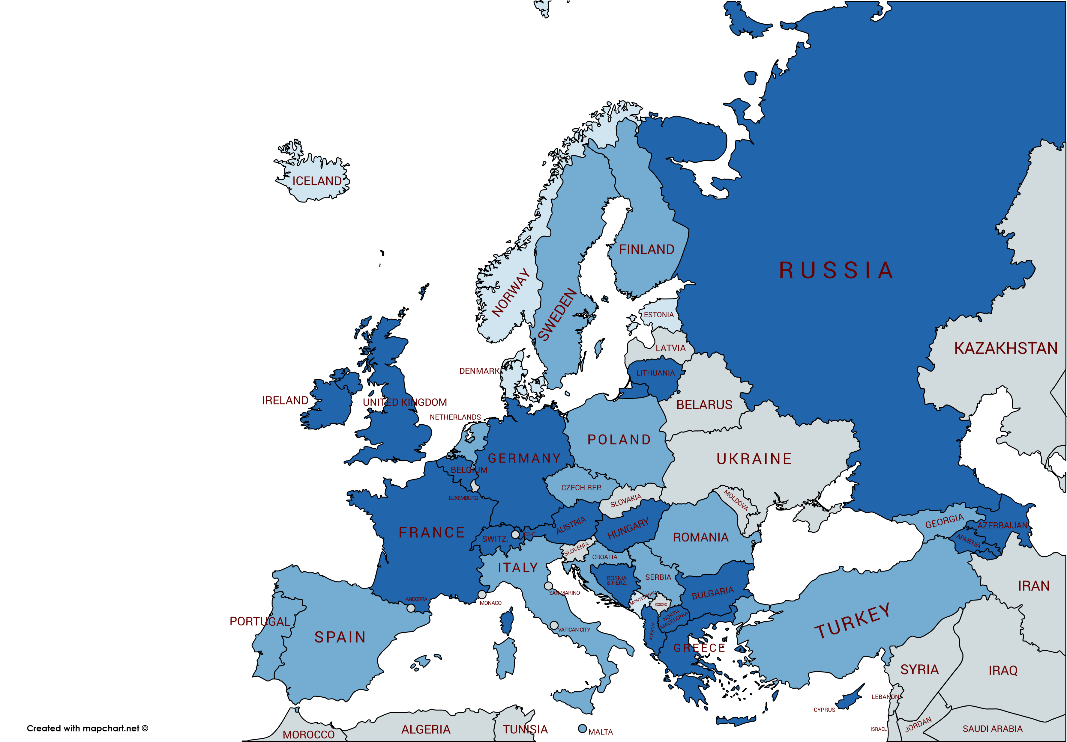
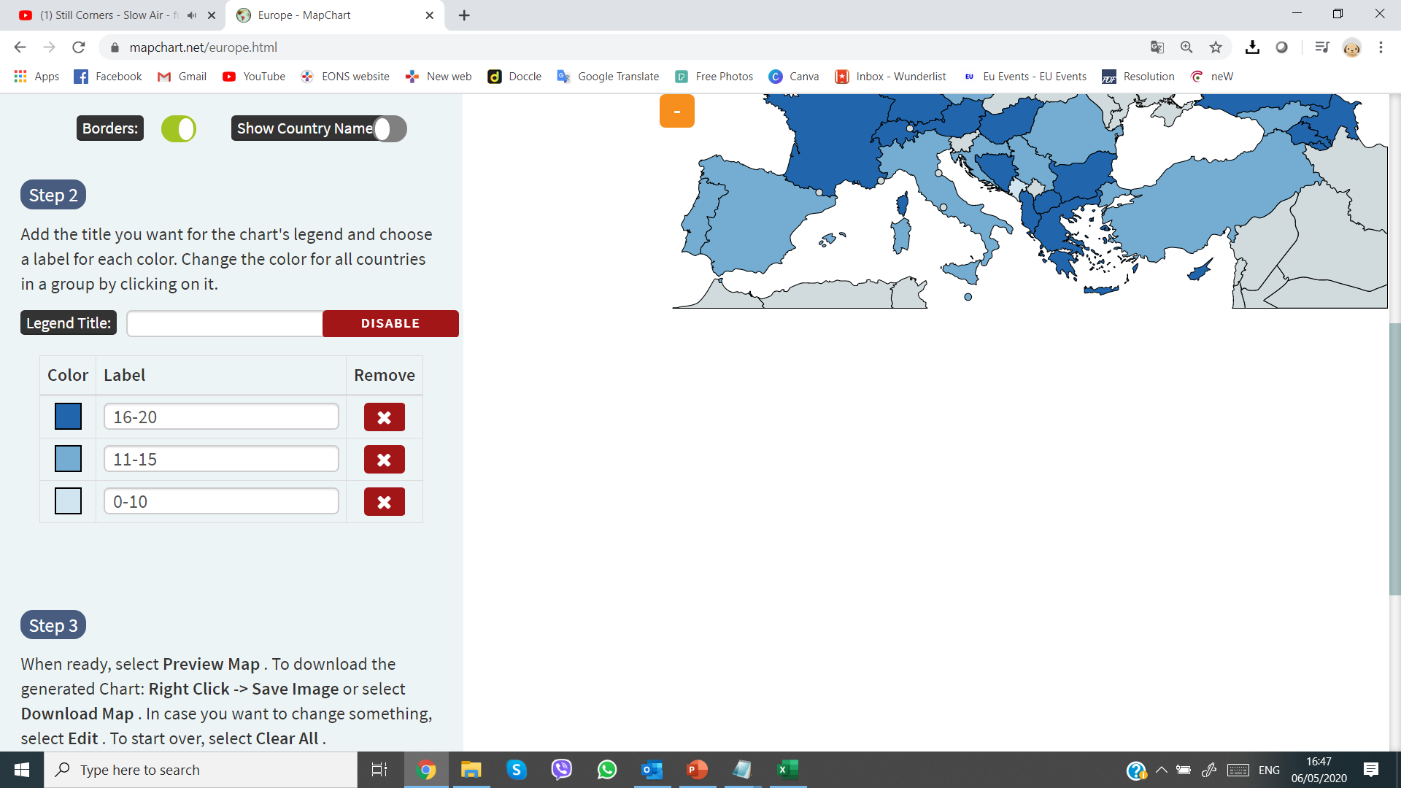
EONS Cancer Nursing Index 2020
Working Conditions and Impact
Scoring System:
#ΕCND20Go4EQUALITY
All rights reserved from
EONS Advocacy Working Group© 2020
Find out more: www.cancernurse.eu
PALESTINE

Slide 4
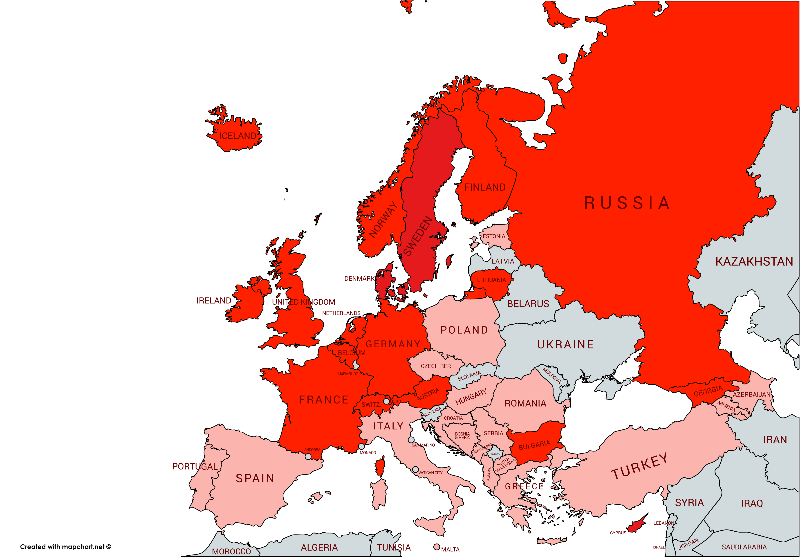
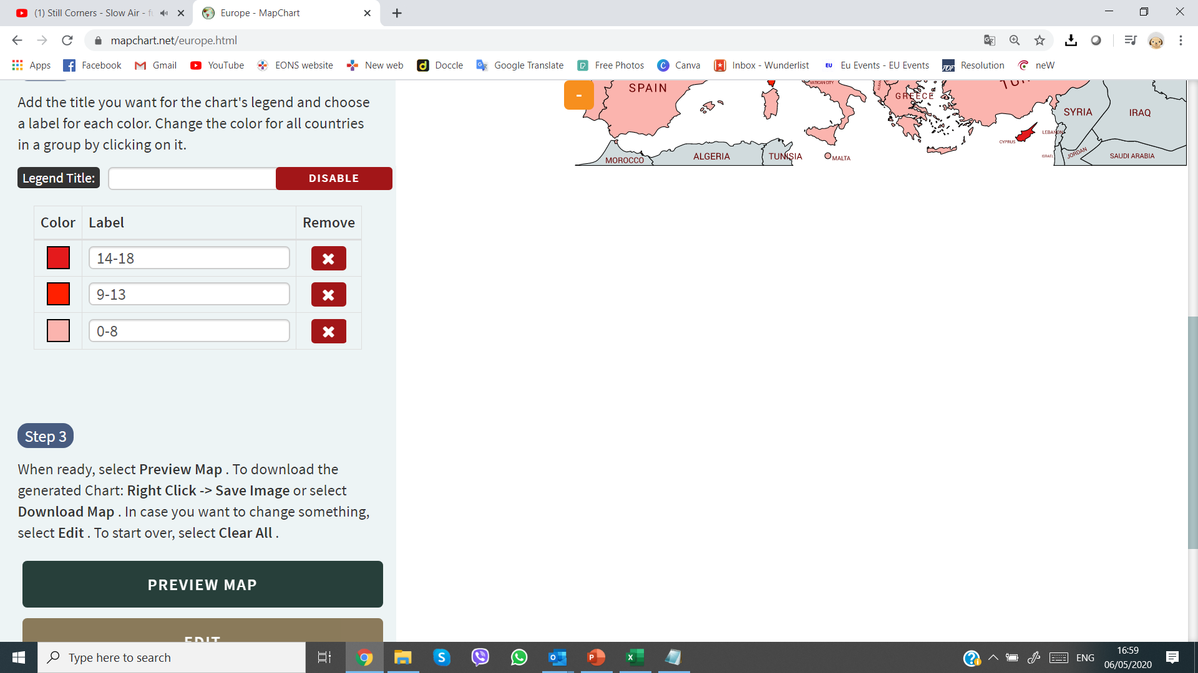
EONS Cancer Nursing Index 2020
Recognition
Scoring System:
#ΕCND20Go4EQUALITY
All rights reserved from
EONS Advocacy Working Group© 2020
Find out more: www.cancernurse.eu
PALESTINE

Slide 5
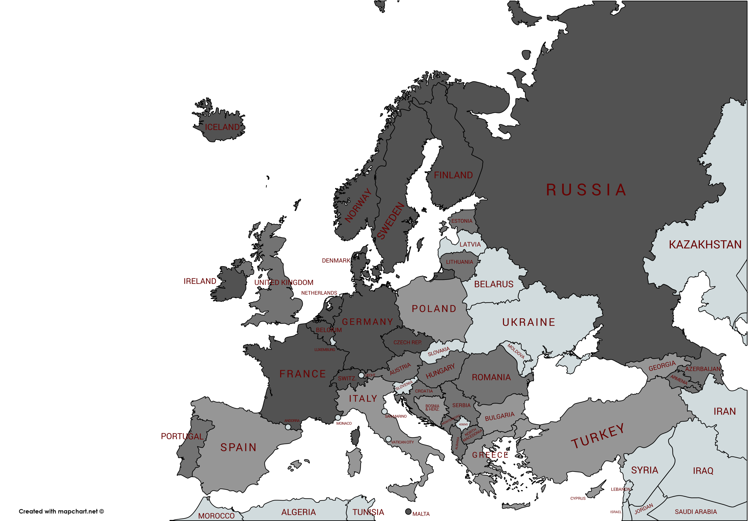
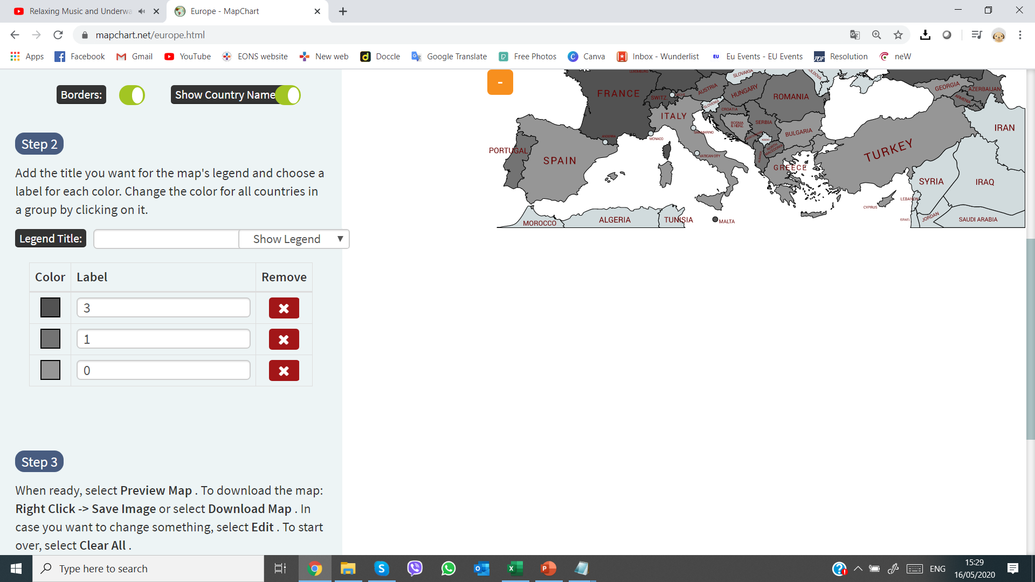
EONS Cancer Nursing Index 2020
Workforce
Scoring System:
#ΕCND20Go4EQUALITY
All rights reserved from
EONS Advocacy Working Group© 2020
Find out more: www.cancernurse.eu
PALESTINE

Slide 6
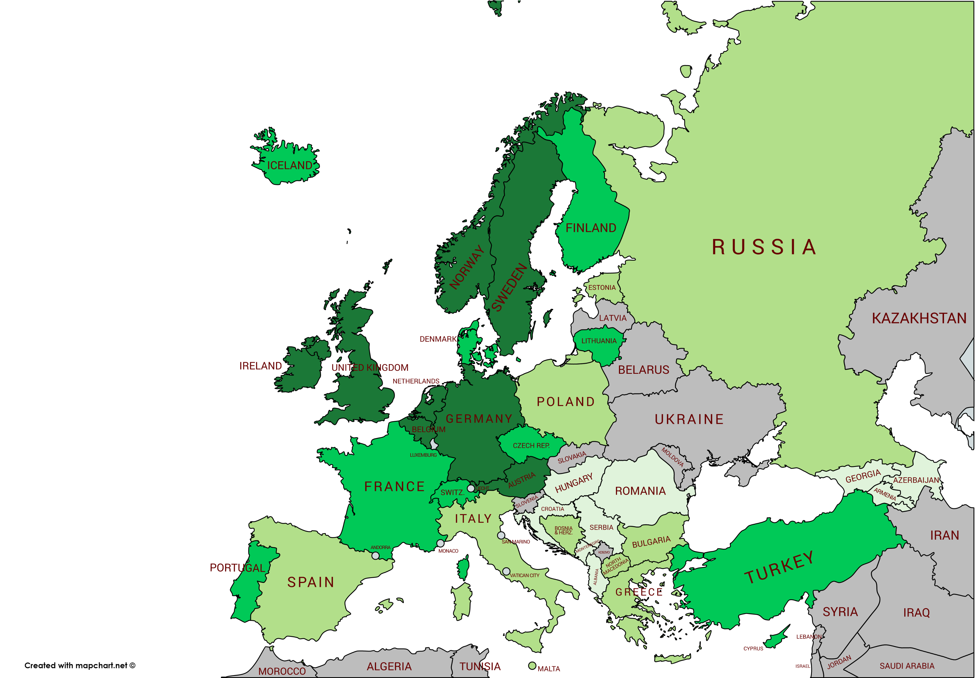
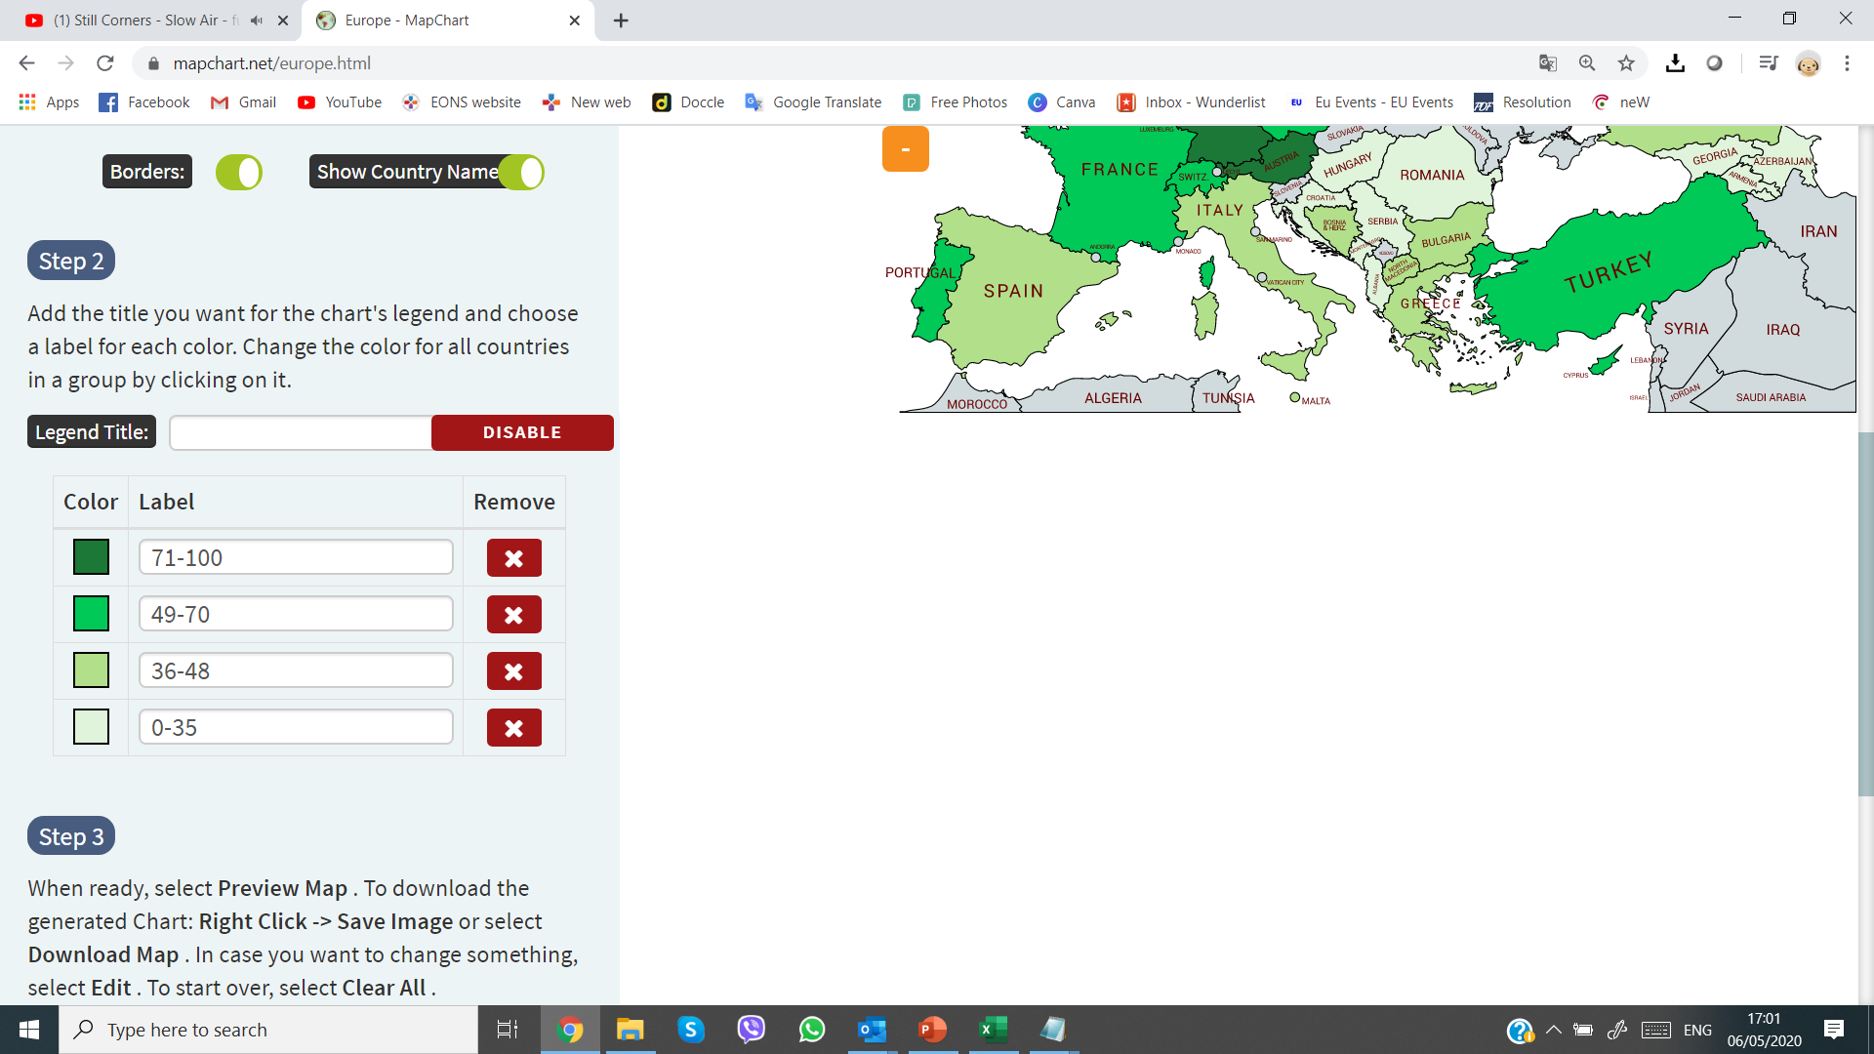
EONS Cancer Nursing Index 2020
Overall Scoring
Scoring System:
#ΕCND20Go4EQUALITY
All rights reserved from
EONS Advocacy Working Group© 2020
Find out more: www.cancernurse.eu
PALESTINE

