Slide 1
ENSURE THAT YOUR CHILDREN TAKE PART IN VACCINATION PROGRAMMES: HEPATITIS B HPV
Messages for general public
#PrEvCan #CANCERCODE
The PrEvCan campaign was initiated by EONS and is run in association with key campaign partner, ESMO. More info: www.cancernurse.eu/prevcan

Slide 2
Insert logo of your organization
here
ENSURE THAT YOUR CHILDREN TAKE PART IN VACCINATION PROGRAMMES: HEPATITIS B HPV
Hepatitis B and HPV vaccines will help prevent some types of cancer. Make sure your children get vaccinated. If you have questions, discuss it with your health care provider.
#PrEvCan #CANCERCODE
The PrEvCan campaign was initiated by EONS and is run in association with key campaign partner, ESMO. More info: www.cancernurse.eu/prevcan

Slide 3
ENSURE THAT YOUR CHILDREN TAKE PART IN VACCINATION PROGRAMMES: HEPATITIS B HPV
Messages for healthcare professionals
#PrEvCan #CANCERCODE
The PrEvCan campaign was initiated by EONS and is run in association with key campaign partner, ESMO. More info: www.cancernurse.eu/prevcan

Slide 4
Insert logo of your organization
here
ENSURE THAT YOUR CHILDREN TAKE PART IN VACCINATION PROGRAMMES: HEPATITIS B HPV
Always assess vaccination status for Hepatitis B and HPV among your patients. Recommend and support vaccination for patients and their families, when appropriate, to reduce the cancer risk.
#PrEvCan #CANCERCODE
The PrEvCan campaign was initiated by EONS and is run in association with key campaign partner, ESMO. More info: www.cancernurse.eu/prevcan

Slide 5
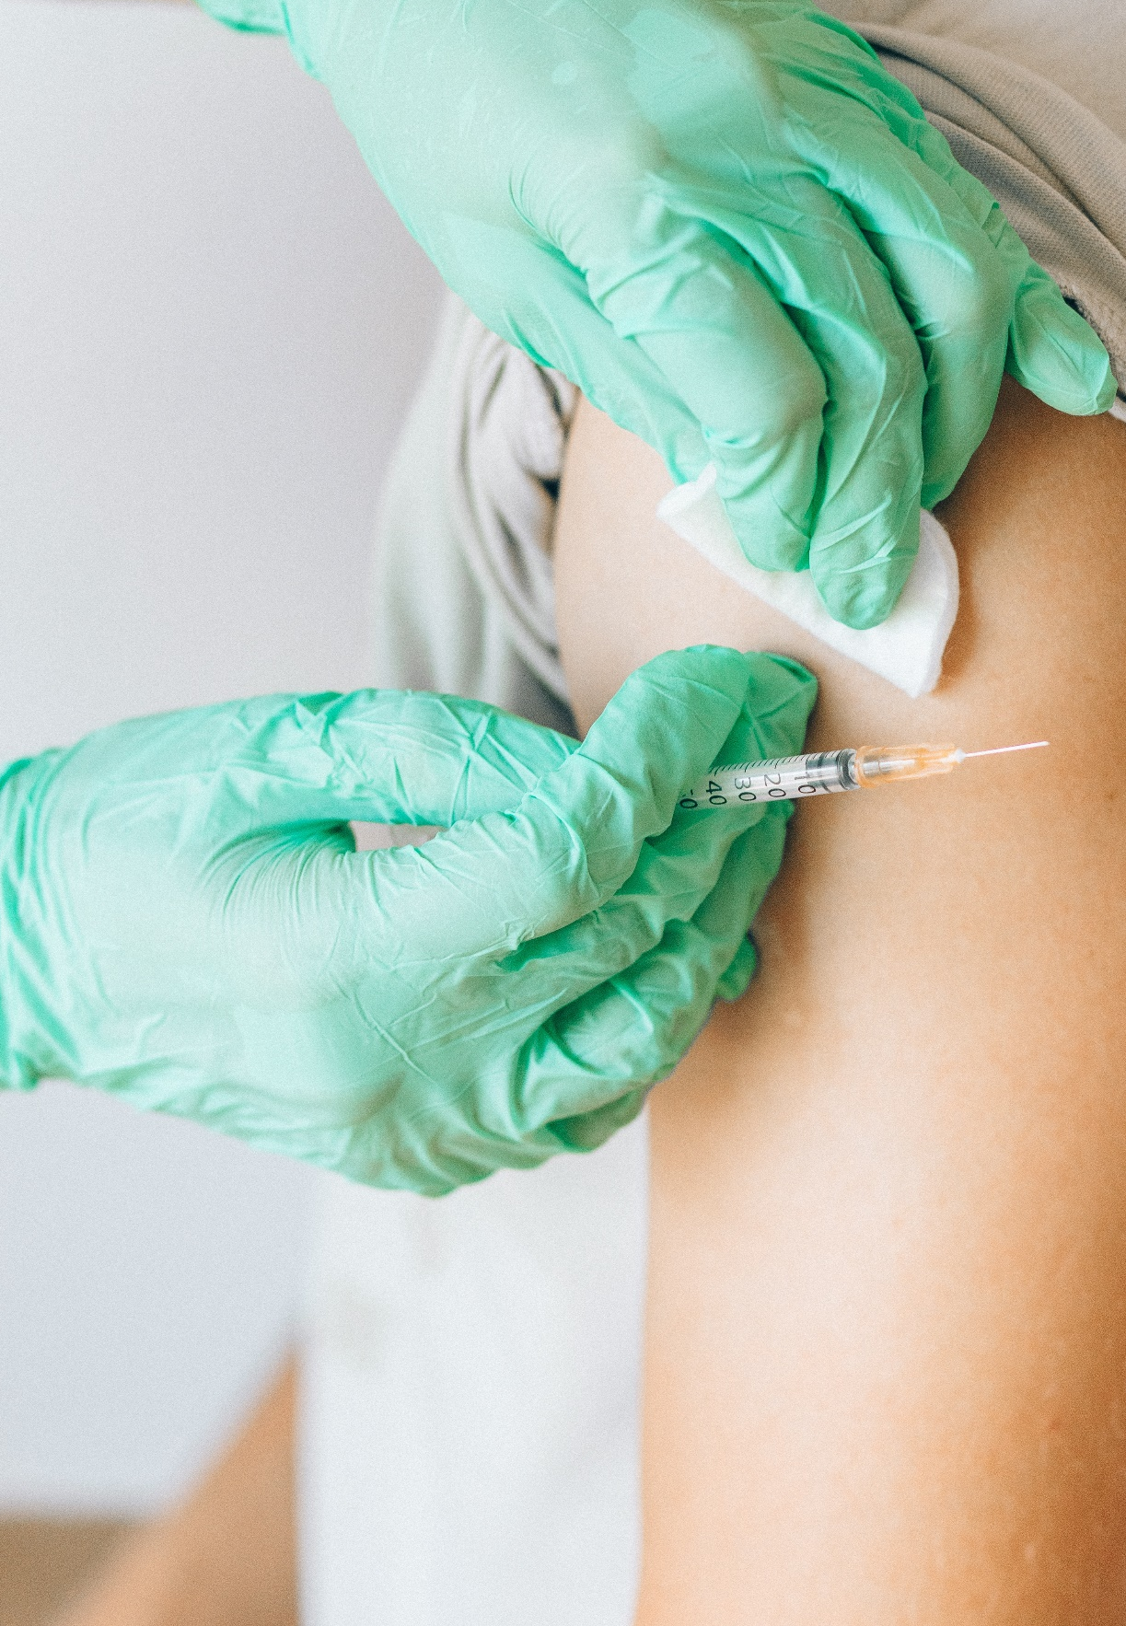
Insert logo of your organization
here
ENSURE THAT YOUR CHILDREN TAKE PART IN VACCINATION PROGRAMMES: HEPATITIS B HPV
Paste your photo
Customized message
#PrEvCan #CANCERCODE
The PrEvCan campaign was initiated by EONS and is run in association with key campaign partner, ESMO. More info: www.cancernurse.eu/prevcan

