Slide 1


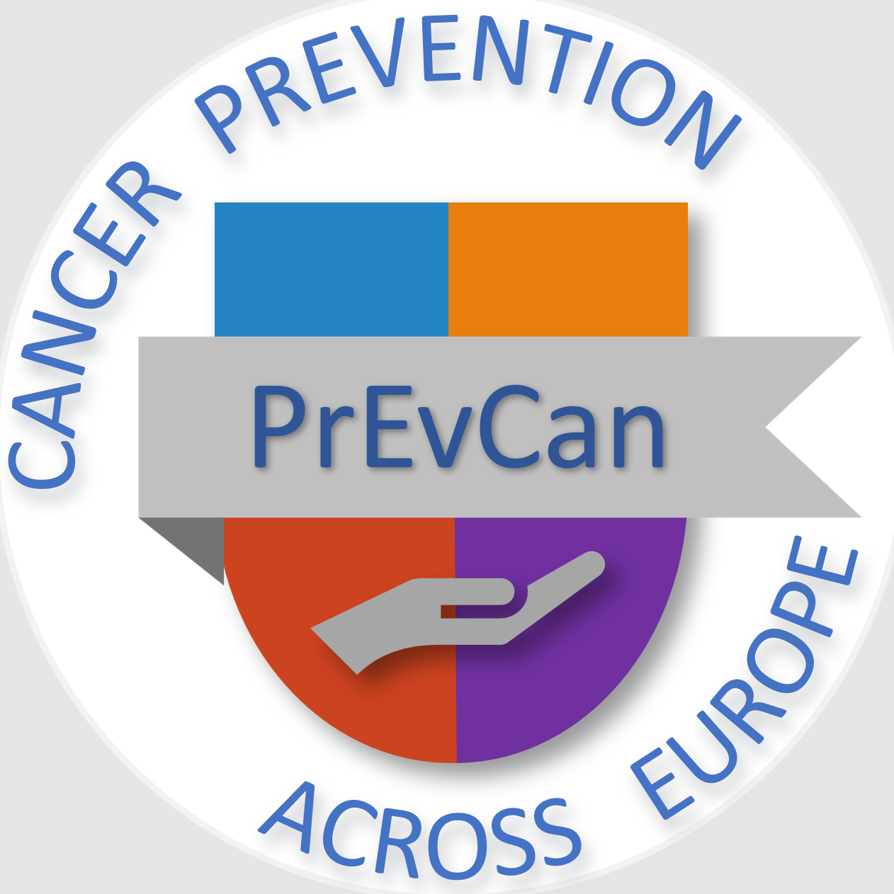

TAKE ACTION
TO REDUCE
HIGH RADON LEVELS
Messages for general public
#PrEvCan #CANCERCODE
The PrEvCan campaign was initiated by EONS and is run in association
with key campaign partner, ESMO. More info: www.cancernurse.eu/prevcan

Slide 2
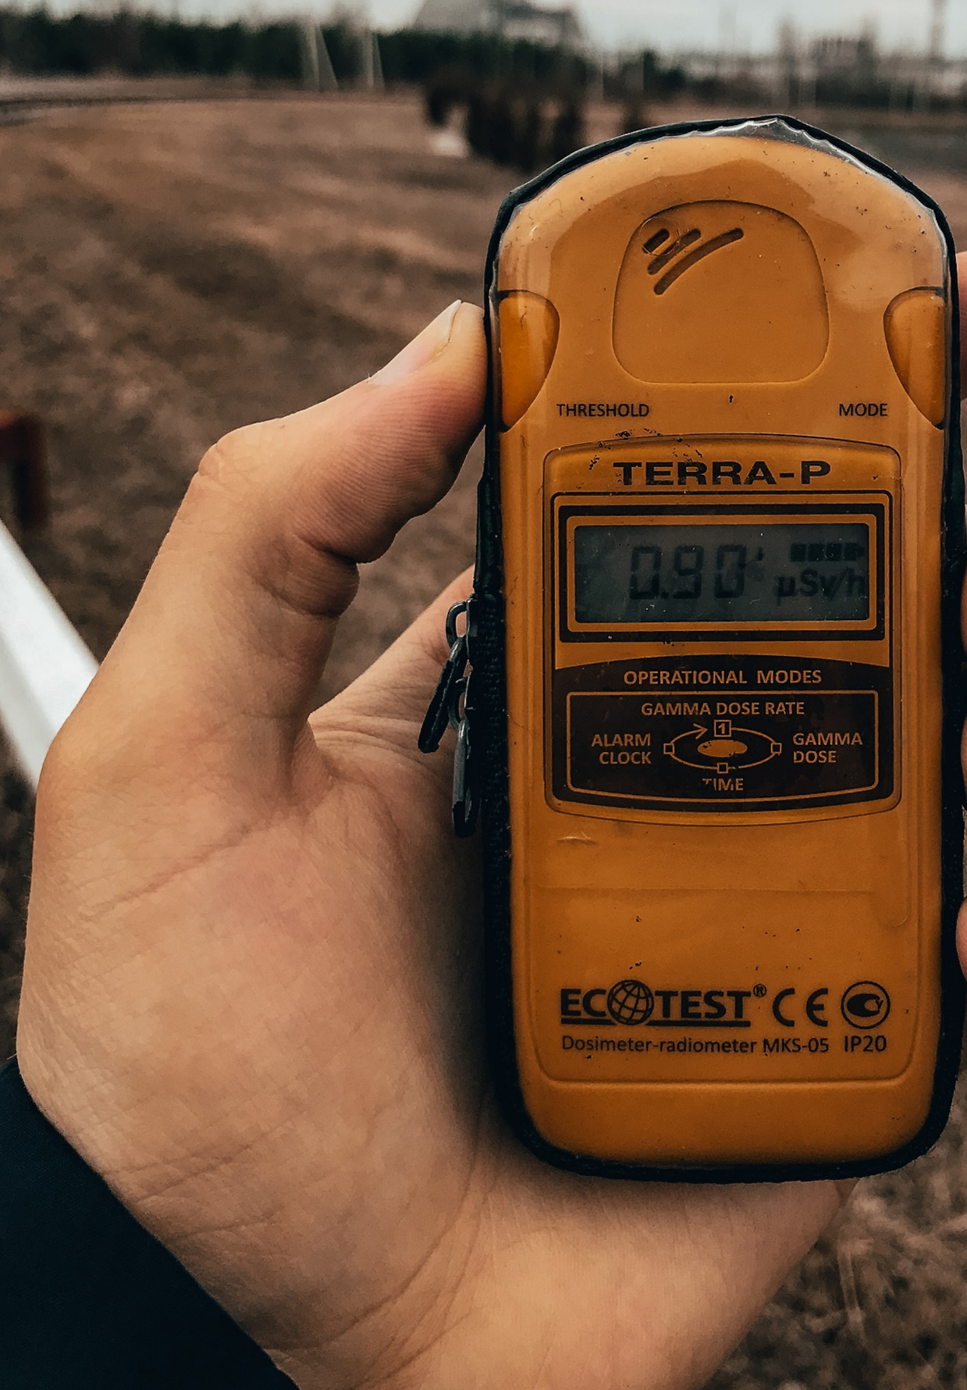
TAKE ACTION
TO REDUCE
HIGH RADON LEVELS
Find out whether
you are exposed
to radiation from naturally
high radon levels
in your home
#PrEvCan #CANCERCODE
The PrEvCan campaign was initiated by EONS and is run in association
with key campaign partner, ESMO. More info: www.cancernurse.eu/prevcan

Slide 3
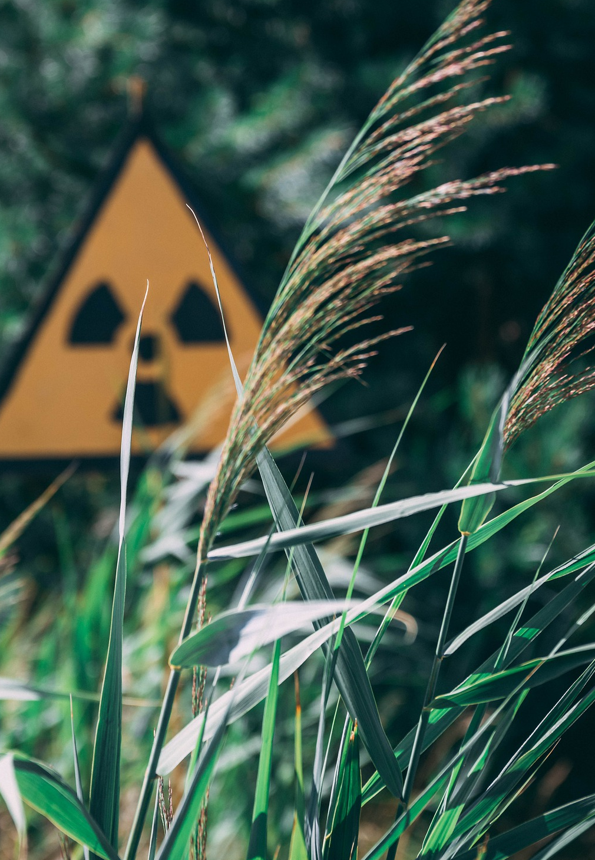
TAKE ACTION
TO REDUCE
HIGH RADON LEVELS
Radon is a natural
radioactive gas
that may cause
radiation exposure
in your home
#PrEvCan #CANCERCODE
The PrEvCan campaign was initiated by EONS and is run in association
with key campaign partner, ESMO. More info: www.cancernurse.eu/prevcan

Slide 4
TAKE ACTION
TO REDUCE
HIGH RADON LEVELS
Paste your photo
Customized
message
#PrEvCan #CANCERCODE
The PrEvCan campaign was initiated by EONS and is run in association
with key campaign partner, ESMO. More info: www.cancernurse.eu/prevcan

