Slide 1
AVOID TOO MUCH SUN DFVDG
USE SUN PROTECTION
DFV
DO NOT USE SUNBEDS
Messages for general public
#PrEvCan #CANCERCODE
The PrEvCan© campaign was initiated by EONS and is run in association with key campaign partner, ESMO. More info: www.cancernurse.eu/prevcan

Slide 2
Insert logo of your organization
here
AVOID TOO MUCH SUN DFVDG
USE SUN PROTECTION
DFV
DO NOT USE SUNBEDS
UV exposure increases your cancer risk. Enjoy the sunshine but be protected.
#PrEvCan #CANCERCODE
The PrEvCan© campaign was initiated by EONS and is run in association with key campaign partner, ESMO. More info: www.cancernurse.eu/prevcan

Slide 3
Insert logo of your organization
here
AVOID TOO MUCH SUN DFVDG
USE SUN PROTECTION
DFV
DO NOT USE SUNBEDS
Stay safe in the sun! Cover up and use sunscreen.
#PrEvCan #CANCERCODE
The PrEvCan© campaign was initiated by EONS and is run in association with key campaign partner, ESMO. More info: www.cancernurse.eu/prevcan

Slide 4
Insert logo of your organization
here
AVOID TOO MUCH SUN DFVDG
USE SUN PROTECTION
DFV
DO NOT USE SUNBEDS
Using tanning beds is unsafe. Avoid them and you will do your skin a favour.
#PrEvCan #CANCERCODE
The PrEvCan© campaign was initiated by EONS and is run in association with key campaign partner, ESMO. More info: www.cancernurse.eu/prevcan

Slide 5
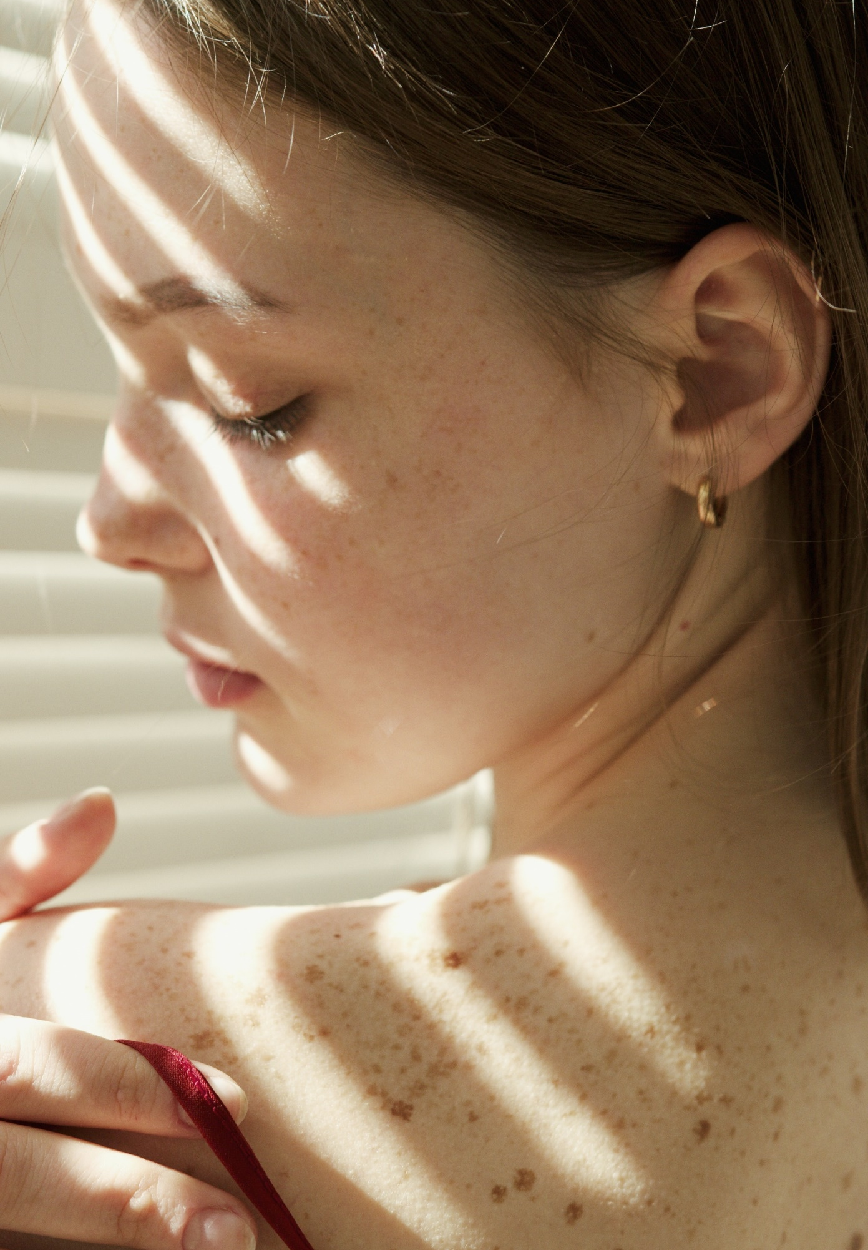
Insert logo of your organization
here
AVOID TOO MUCH SUN DFVDG
USE SUN PROTECTION
DFV
DO NOT USE SUNBEDS
Routinely check your skin for changes. Always contact your healthcare provider if you have any concerns.
#PrEvCan #CANCERCODE
The PrEvCan© campaign was initiated by EONS and is run in association with key campaign partner, ESMO. More info: www.cancernurse.eu/prevcan

Slide 6
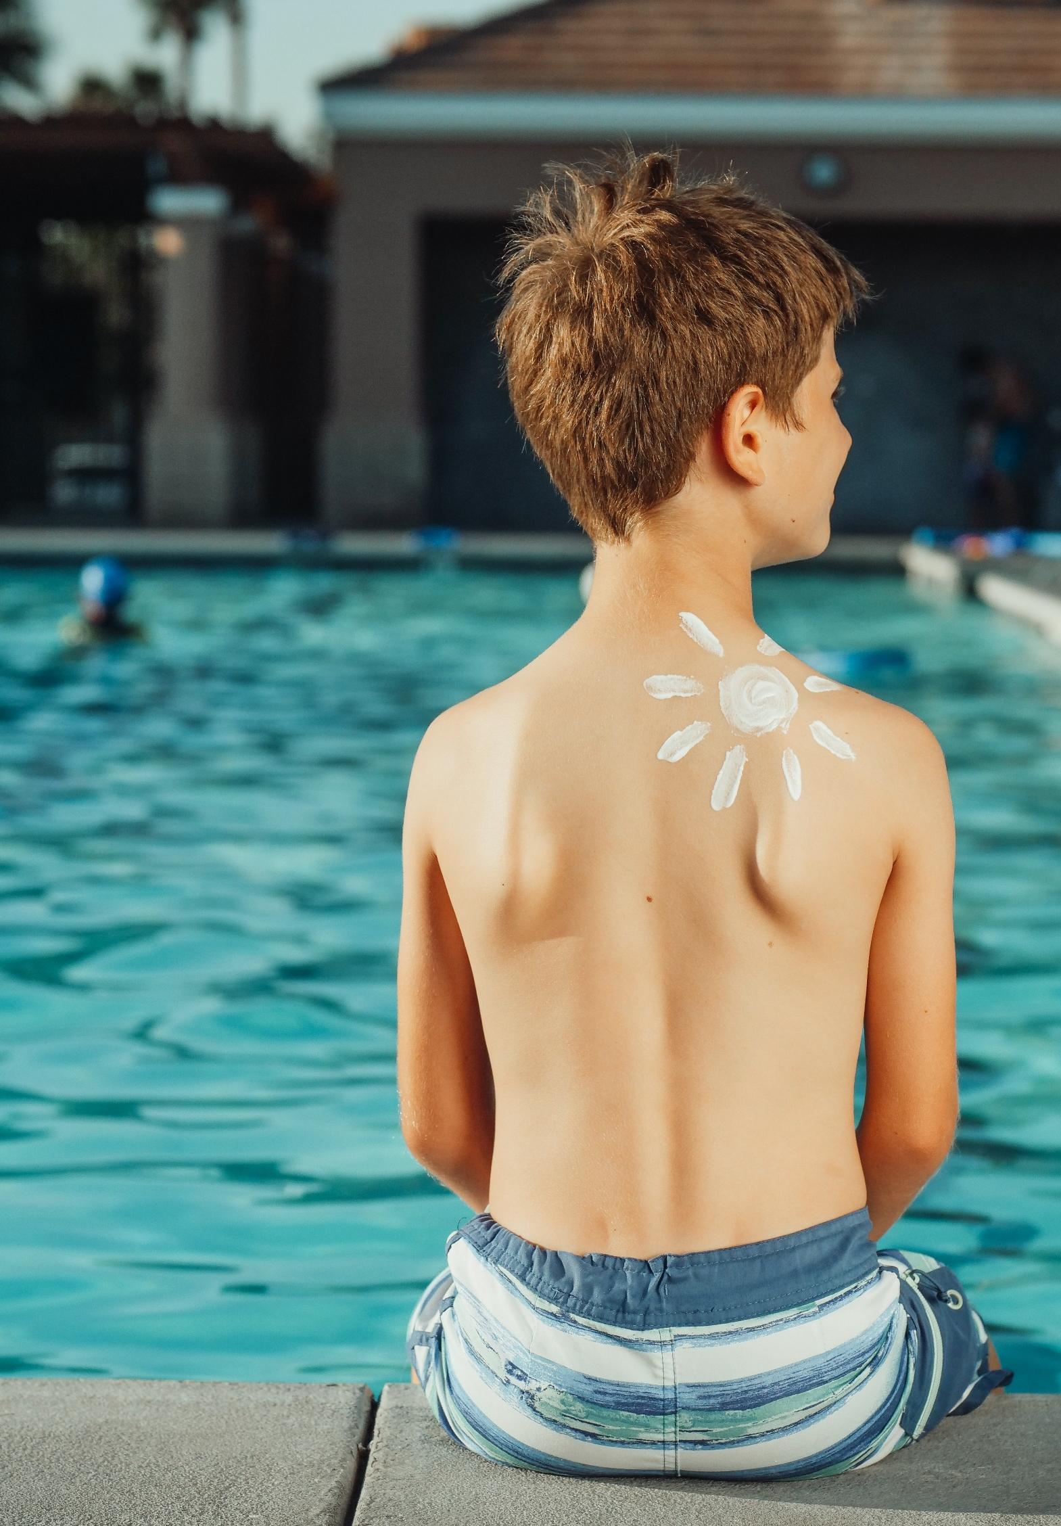
Insert logo of your organization
here
AVOID TOO MUCH SUN DFVDG
USE SUN PROTECTION
DFV
DO NOT USE SUNBEDS
Children and young people are particularly vulnerable to skin damage from the sun
#PrEvCan #CANCERCODE
The PrEvCan© campaign was initiated by EONS and is run in association with key campaign partner, ESMO. More info: www.cancernurse.eu/prevcan

Slide 7
AVOID TOO MUCH SUN DFVDG
USE SUN PROTECTION
DFV
DO NOT USE SUNBEDS
Messages for healthcare professionals
#PrEvCan #CANCERCODE
The PrEvCan© campaign was initiated by EONS and is run in association with key campaign partner, ESMO. More info: www.cancernurse.eu/prevcan

Slide 8
Insert logo of your organization
here
AVOID TOO MUCH SUN DFVDG
USE SUN PROTECTION
DFV
DO NOT USE SUNBEDS
Melanoma is increasing and annually kills more than 20,000 people in Europe
#PrEvCan #CANCERCODE
The PrEvCan© campaign was initiated by EONS and is run in association with key campaign partner, ESMO. More info: www.cancernurse.eu/prevcan

Slide 9
Insert logo of your organization
here
AVOID TOO MUCH SUN DFVDG
USE SUN PROTECTION
DFV
DO NOT USE SUNBEDS
Advise your patients to stay safe in the sun by covering up and using sunscreen
#PrEvCan #CANCERCODE
The PrEvCan© campaign was initiated by EONS and is run in association with key campaign partner, ESMO. More info: www.cancernurse.eu/prevcan

Slide 10
Insert logo of your organization
here
AVOID TOO MUCH SUN DFVDG
USE SUN PROTECTION
DFV
DO NOT USE SUNBEDS
Always refer patients with any skin concerns to an expert
#PrEvCan #CANCERCODE
The PrEvCan© campaign was initiated by EONS and is run in association with key campaign partner, ESMO. More info: www.cancernurse.eu/prevcan

Slide 11
Insert logo of your organization
here
AVOID TOO MUCH SUN DFVDG
USE SUN PROTECTION
DFV
DO NOT USE SUNBEDS
Paste your photo
Customized message
#PrEvCan #CANCERCODE
The PrEvCan© campaign was initiated by EONS and is run in association with key campaign partner, ESMO. More info: www.cancernurse.eu/prevcan

