Slide 1
LIMIT YOUR ALCOHOL INTAKE
Messages for general public
#PrEvCan #CANCERCODE
The PrEvCan© campaign was initiated by EONS and is run in association with key campaign partner, ESMO. More info: www.cancernurse.eu/prevcan

Slide 2
Insert logo of your organization
here
LIMIT YOUR ALCOHOL INTAKE
If you drink alcohol of any type, limit your intake. Not drinking alcohol is better for cancer prevention.
#PrEvCan #CANCERCODE
The PrEvCan© campaign was initiated by EONS and is run in association with key campaign partner, ESMO. More info: www.cancernurse.eu/prevcan

Slide 3
Insert logo of your organization
here
LIMIT YOUR ALCOHOL INTAKE
Drinking alcohol is associated with at least 8 types of cancer
#PrEvCan #CANCERCODE
The PrEvCan© campaign was initiated by EONS and is run in association with key campaign partner, ESMO. More info: www.cancernurse.eu/prevcan

Slide 4
Insert logo of your organization
here
LIMIT YOUR ALCOHOL INTAKE
The less alcohol you drink, the lower your risk for cancer
#PrEvCan #CANCERCODE
The PrEvCan© campaign was initiated by EONS and is run in association with key campaign partner, ESMO. More info: www.cancernurse.eu/prevcan

Slide 5
Insert logo of your organization
here
LIMIT YOUR ALCOHOL INTAKE
Ask your nurse or other health care provider for support
#PrEvCan #CANCERCODE
The PrEvCan© campaign was initiated by EONS and is run in association with key campaign partner, ESMO. More info: www.cancernurse.eu/prevcan

Slide 6
LIMIT YOUR ALCOHOL INTAKE
Messages for healthcare professionals
#PrEvCan #CANCERCODE
The PrEvCan© campaign was initiated by EONS and is run in association with key campaign partner, ESMO. More info: www.cancernurse.eu/prevcan

Slide 7
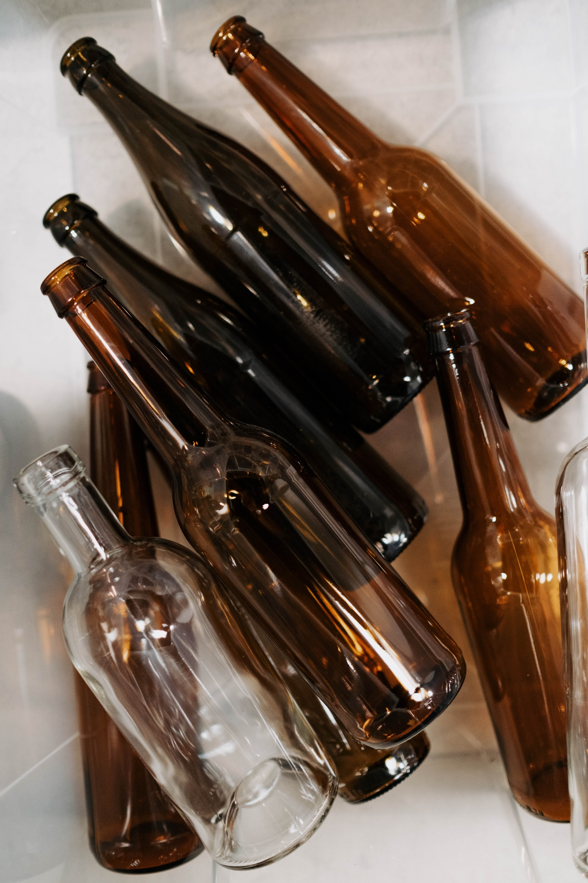
Insert logo of your organization
here
LIMIT YOUR ALCOHOL INTAKE
Always assess whether your patients are drinking alcohol
#PrEvCan #CANCERCODE
The PrEvCan© campaign was initiated by EONS and is run in association with key campaign partner, ESMO. More info: www.cancernurse.eu/prevcan

Slide 8
Insert logo of your organization
here
LIMIT YOUR ALCOHOL INTAKE
Offer advice, support and follow-up
#PrEvCan #CANCERCODE
The PrEvCan© campaign was initiated by EONS and is run in association with key campaign partner, ESMO. More info: www.cancernurse.eu/prevcan

Slide 9
Insert logo of your organization
here
LIMIT YOUR ALCOHOL INTAKE
Paste your photo
Customized message
#PrEvCan #CANCERCODE
The PrEvCan© campaign was initiated by EONS and is run in association with key campaign partner, ESMO. More info: www.cancernurse.eu/prevcan

