Slide 1
BE PHYSICALLY
ACTIVE IN EVERYDAY LIFE
LIMIT THE TIME YOU SPEND SITTING
Messages for general public
#PrEvCan #CANCERCODE
The PrEvCan campaign was initiated by EONS and is run in association with key campaign partner, ESMO. More info: www.cancernurse.eu/prevcan

Slide 2
Insert logo of your organization
here
BE PHYSICALLY
ACTIVE IN EVERYDAY LIFE
LIMIT THE TIME YOU SPEND SITTING
150 minutes of moderate intensity physical activity per week will reduce your cancer risk!
#PrEvCan #CANCERCODE
The PrEvCan campaign was initiated by EONS and is run in association with key campaign partner, ESMO. More info: www.cancernurse.eu/prevcan

Slide 3
Insert logo of your organization
here
BE PHYSICALLY
ACTIVE IN EVERYDAY LIFE
LIMIT THE TIME YOU SPEND SITTING
Take the stairs, walk, run, cycle, swim, jump, dance, whenever you can!
#PrEvCan #CANCERCODE
The PrEvCan campaign was initiated by EONS and is run in association with key campaign partner, ESMO. More info: www.cancernurse.eu/prevcan

Slide 4
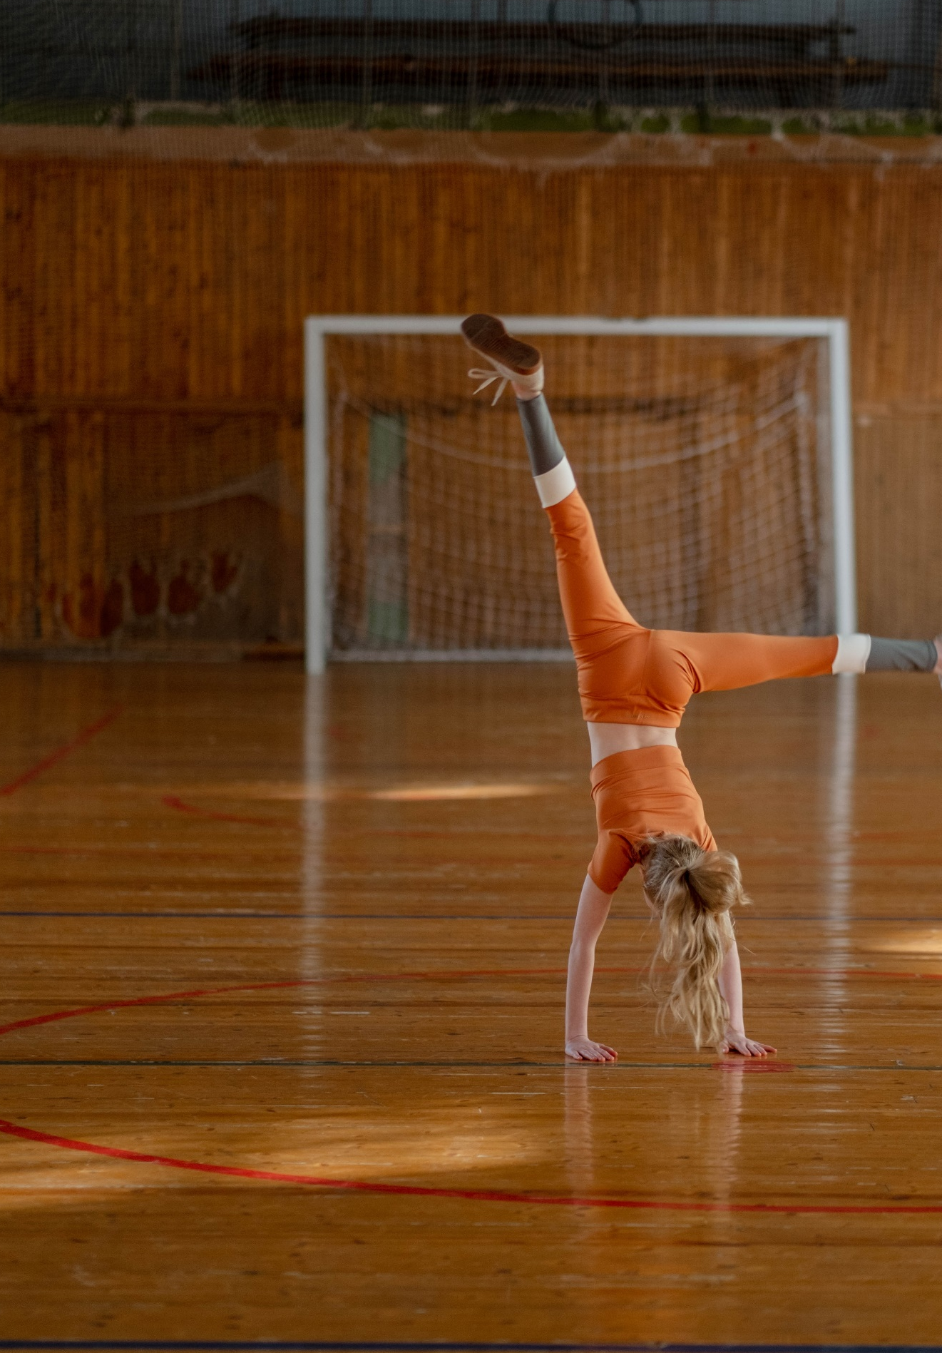
Insert logo of your organization
here
BE PHYSICALLY
ACTIVE IN EVERYDAY LIFE
LIMIT THE TIME YOU SPEND SITTING
Take the stairs, walk, run, cycle, swim, jump, dance, whenever you can!
#PrEvCan #CANCERCODE
The PrEvCan campaign was initiated by EONS and is run in association with key campaign partner, ESMO. More info: www.cancernurse.eu/prevcan

Slide 5
Insert logo of your organization
here
BE PHYSICALLY
ACTIVE IN EVERYDAY LIFE
LIMIT THE TIME YOU SPEND SITTING
Get moving for health!
#PrEvCan #CANCERCODE
The PrEvCan campaign was initiated by EONS and is run in association with key campaign partner, ESMO. More info: www.cancernurse.eu/prevcan

Slide 6
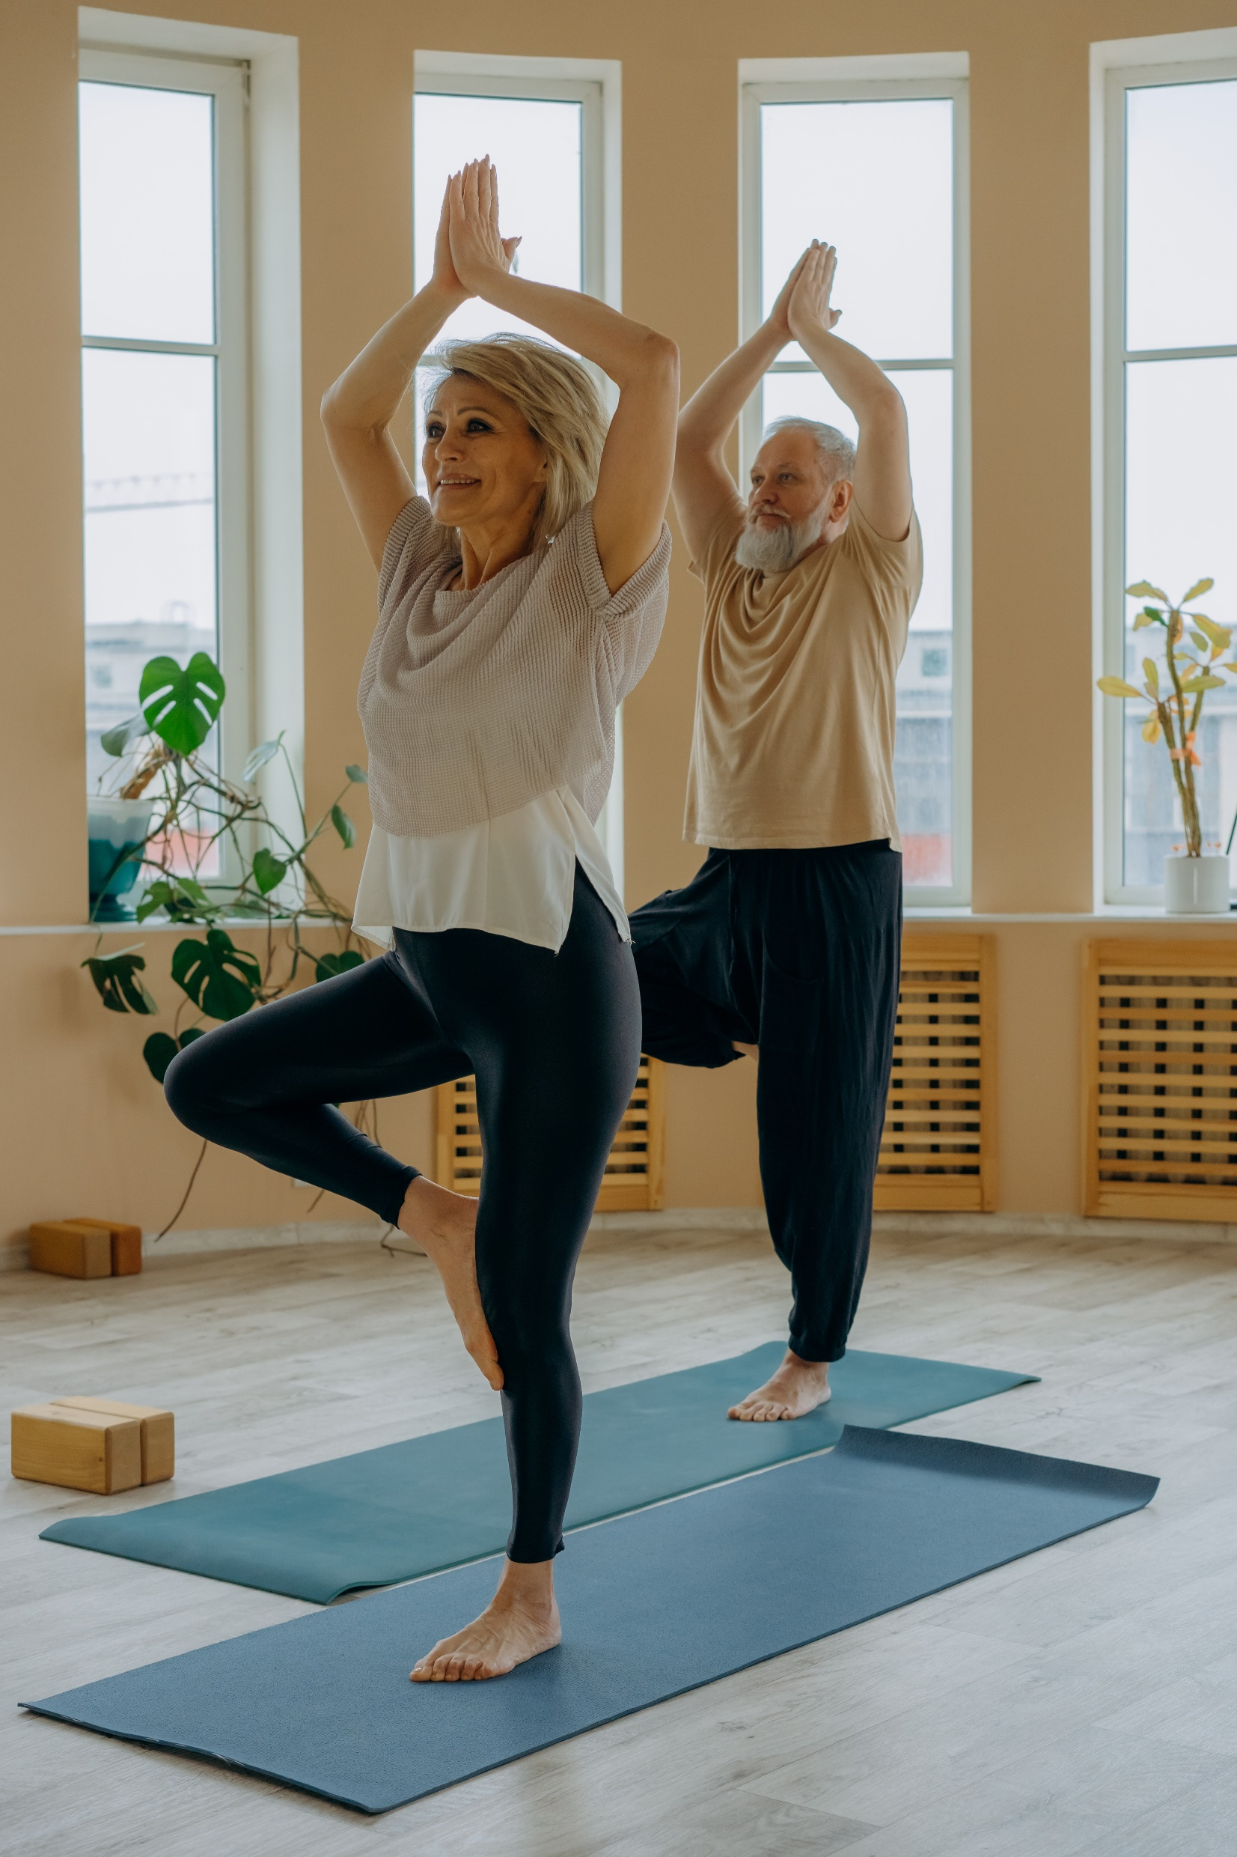
Insert logo of your organization
here
BE PHYSICALLY
ACTIVE IN EVERYDAY LIFE
LIMIT THE TIME YOU SPEND SITTING
Being physically active reduces the likelihood of some of the most common cancers and also other diseases
#PrEvCan #CANCERCODE
The PrEvCan campaign was initiated by EONS and is run in association with key campaign partner, ESMO. More info: www.cancernurse.eu/prevcan

Slide 7
BE PHYSICALLY
ACTIVE IN EVERYDAY LIFE
LIMIT THE TIME YOU SPEND SITTING
Messages for healthcare professionals
#PrEvCan #CANCERCODE
The PrEvCan campaign was initiated by EONS and is run in association with key campaign partner, ESMO. More info: www.cancernurse.eu/prevcan

Slide 8
Insert logo of your organization
here
BE PHYSICALLY
ACTIVE IN EVERYDAY LIFE
LIMIT THE TIME YOU SPEND SITTING
Ask your patients about physical activities!
#PrEvCan #CANCERCODE
The PrEvCan campaign was initiated by EONS and is run in association with key campaign partner, ESMO. More info: www.cancernurse.eu/prevcan

Slide 9
Insert logo of your organization
here
BE PHYSICALLY
ACTIVE IN EVERYDAY LIFE
LIMIT THE TIME YOU SPEND SITTING
Recommend at least 150 minutes of moderate intensity physical activity of per week for patients that can
#PrEvCan #CANCERCODE
The PrEvCan campaign was initiated by EONS and is run in association with key campaign partner, ESMO. More info: www.cancernurse.eu/prevcan

Slide 10
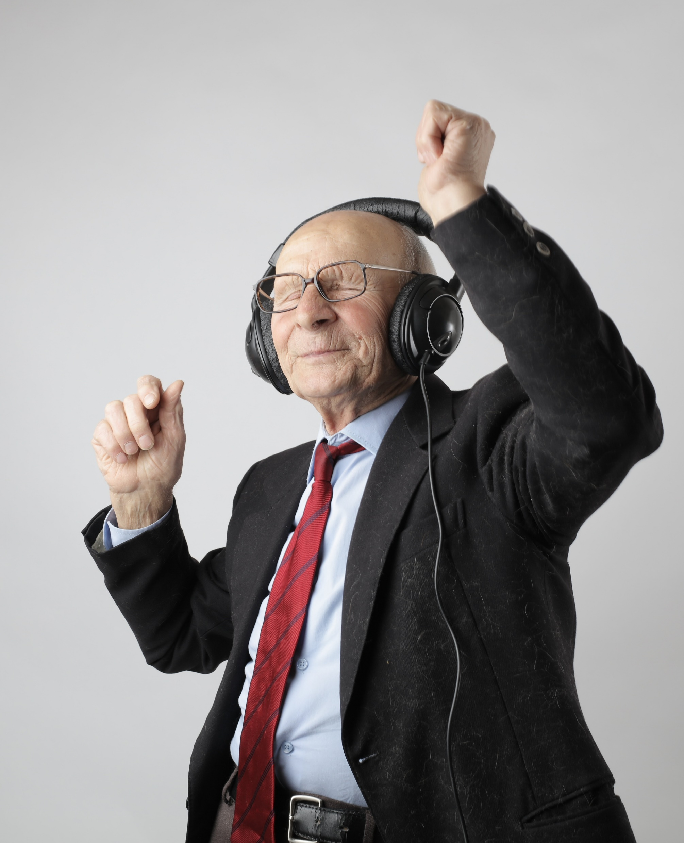
Insert logo of your organization
here
BE PHYSICALLY
ACTIVE IN EVERYDAY LIFE
LIMIT THE TIME YOU SPEND SITTING
Any physical activity is better than none!
#PrEvCan #CANCERCODE
The PrEvCan campaign was initiated by EONS and is run in association with key campaign partner, ESMO. More info: www.cancernurse.eu/prevcan

Slide 11
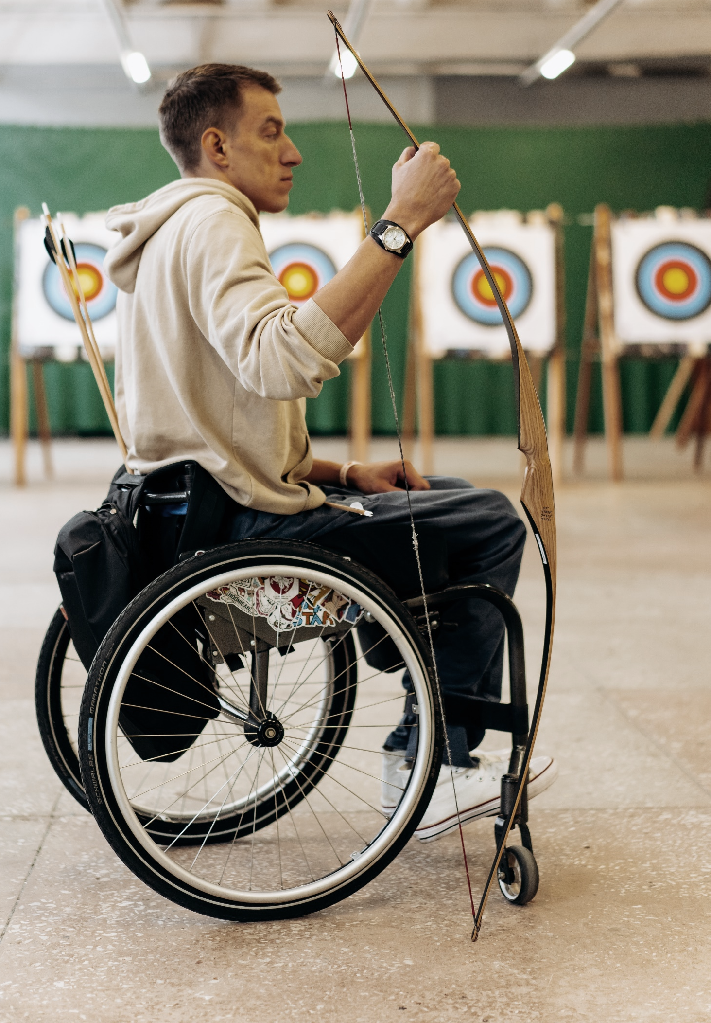
Insert logo of your organization
here
BE PHYSICALLY
ACTIVE IN EVERYDAY LIFE
LIMIT THE TIME YOU SPEND SITTING
Provide support and tailor recommendations for patients at risk for inactivity
#PrEvCan #CANCERCODE
The PrEvCan campaign was initiated by EONS and is run in association with key campaign partner, ESMO. More info: www.cancernurse.eu/prevcan

Slide 12
Insert logo of your organization
here
BE PHYSICALLY
ACTIVE IN EVERYDAY LIFE
LIMIT THE TIME YOU SPEND SITTING
Paste your photo
Customized text
#PrEvCan #CANCERCODE
The PrEvCan campaign was initiated by EONS and is run in association with key campaign partner, ESMO. More info: www.cancernurse.eu/prevcan

