Slide 1
TAKE ACTION TO BE A HEALTHY BODY WEIGHT
Messages for general public
#PrEvCan #CANCERCODE
The PrEvCan© campaign was initiated by EONS and is run in association with key campaign partner, ESMO. More info: www.cancernurse.eu/prevcan

Slide 2
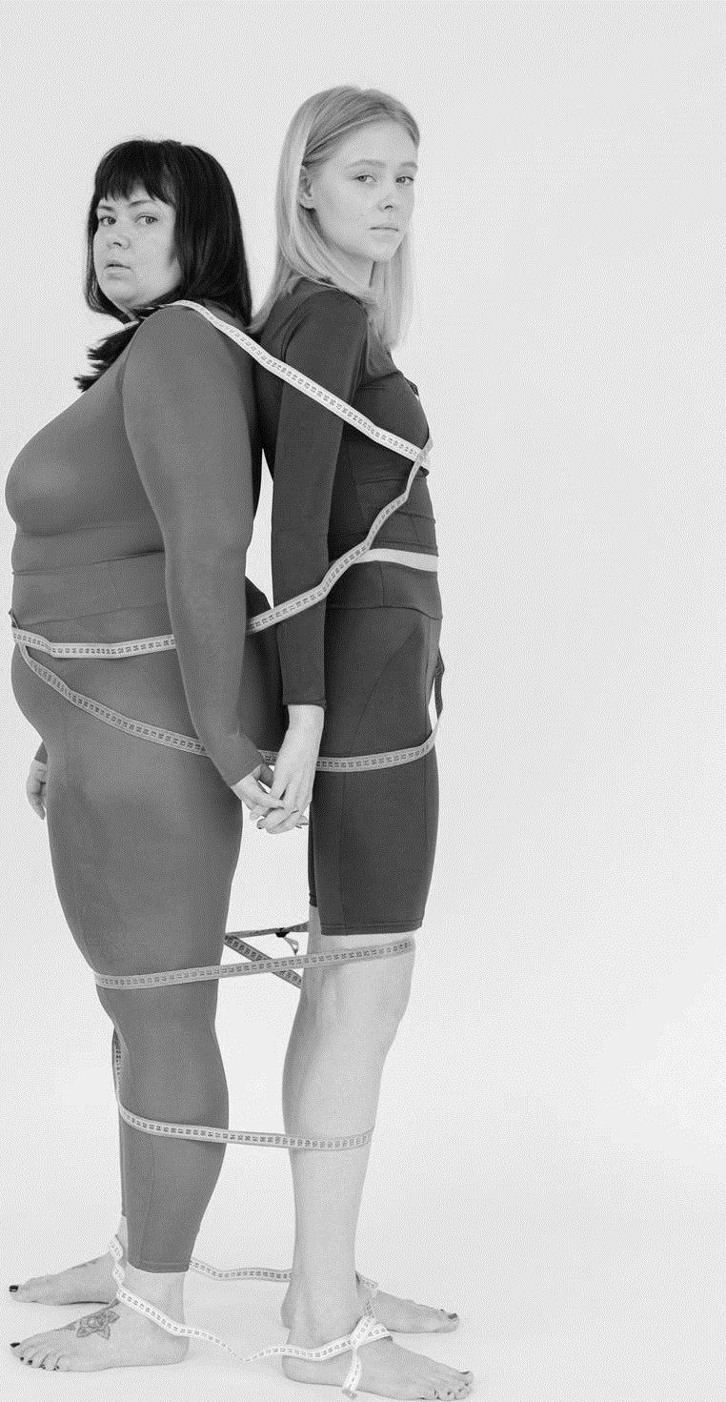
Insert logo of your organization
here
TAKE ACTION TO BE A HEALTHY BODY WEIGHT
Stay under this line for optimal health
waistline: men ≤ 102 cm women ≤ 88 cm
#PrEvCan #CANCERCODE
The PrEvCan© campaign was initiated by EONS and is run in association with key campaign partner, ESMO. More info: www.cancernurse.eu/prevcan

Slide 3
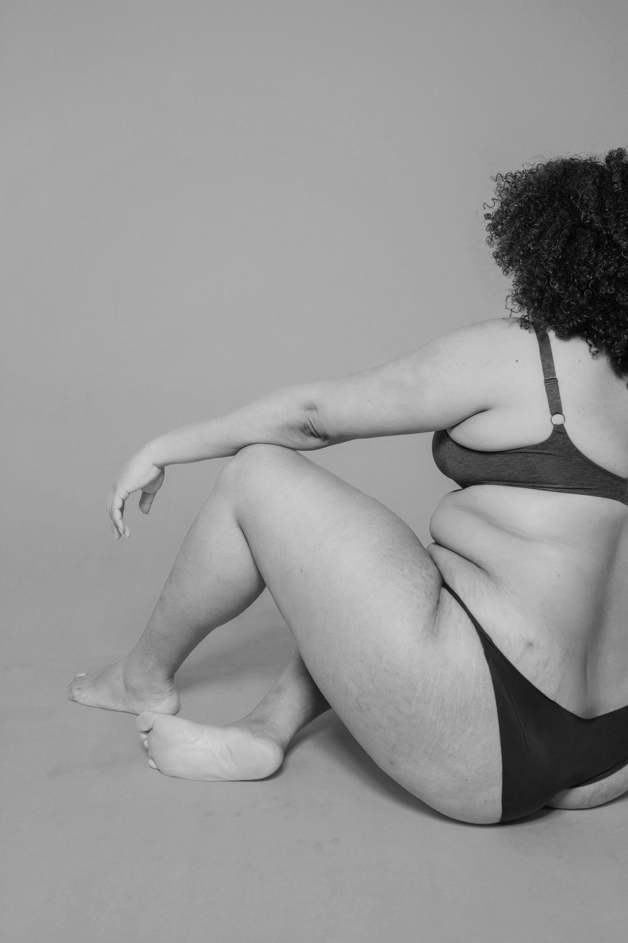
Insert logo of your organization
here
TAKE ACTION TO BE A HEALTHY BODY WEIGHT
Being overweight or obese is linked with a higher risk of getting cancer, heart disease and diabetes
#PrEvCan #CANCERCODE
The PrEvCan© campaign was initiated by EONS and is run in association with key campaign partner, ESMO. More info: www.cancernurse.eu/prevcan

Slide 4
Insert logo of your organization
here
TAKE ACTION TO BE A HEALTHY BODY WEIGHT
Drop belly fat, reduce the risk for certain cancers
#PrEvCan #CANCERCODE
The PrEvCan© campaign was initiated by EONS and is run in association with key campaign partner, ESMO. More info: www.cancernurse.eu/prevcan

Slide 5
Insert logo of your organization
here
TAKE ACTION TO BE A HEALTHY BODY WEIGHT
If you need support, ask a nurse or other healthcare professional
#PrEvCan #CANCERCODE
The PrEvCan© campaign was initiated by EONS and is run in association with key campaign partner, ESMO. More info: www.cancernurse.eu/prevcan

Slide 6
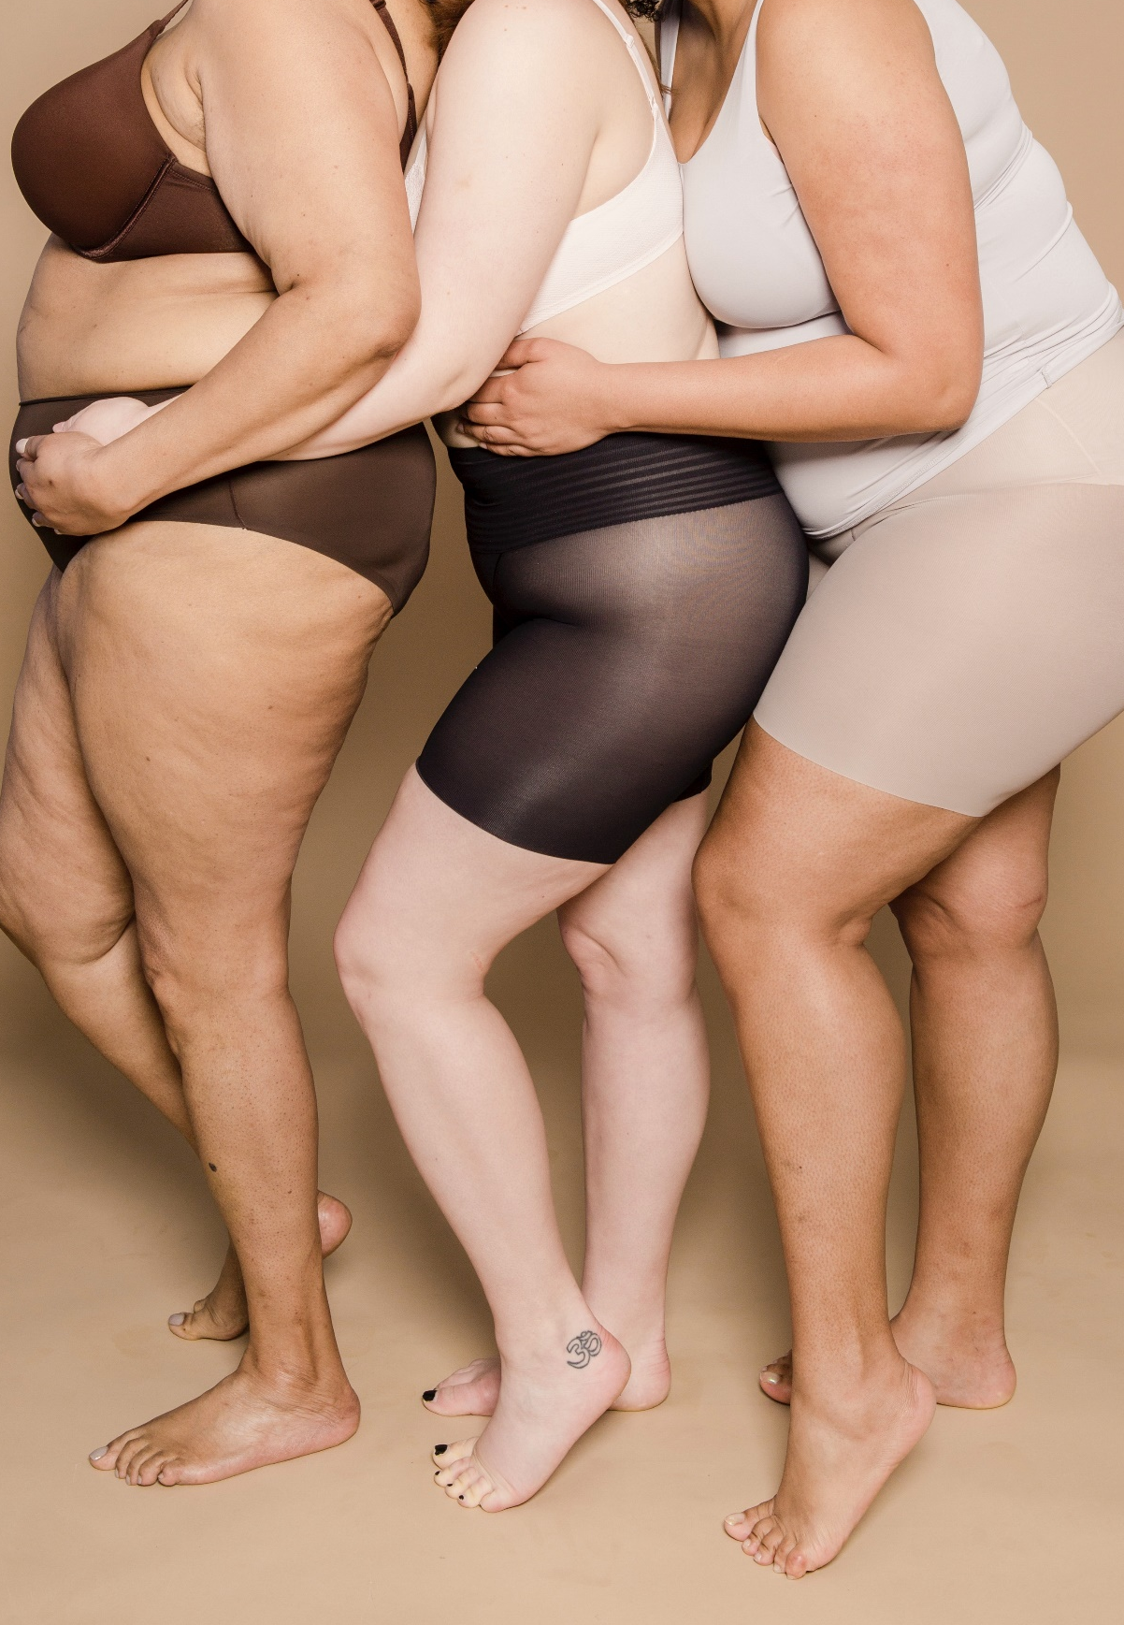
Insert logo of your organization
here
TAKE ACTION TO BE A HEALTHY BODY WEIGHT
Overweight and obesity are associated with increased risk of 13 types of cancer
#PrEvCan #CANCERCODE
The PrEvCan© campaign was initiated by EONS and is run in association with key campaign partner, ESMO. More info: www.cancernurse.eu/prevcan

Slide 7
TAKE ACTION TO BE A HEALTHY BODY WEIGHT
Messages for healthcare professionals
#PrEvCan #CANCERCODE
The PrEvCan© campaign was initiated by EONS and is run in association with key campaign partner, ESMO. More info: www.cancernurse.eu/prevcan

Slide 8
Insert logo of your organization
here
TAKE ACTION TO BE A HEALTHY BODY WEIGHT
55 % of all cancers diagnosed in women and 24 % of those diagnosed in men are associated with being overweight or obese.
Be pro-active! Assess, advice and support weight loss among your patients!
#PrEvCan #CANCERCODE
The PrEvCan© campaign was initiated by EONS and is run in association with key campaign partner, ESMO. More info: www.cancernurse.eu/prevcan

Slide 9
Insert logo of your organization
here
TAKE ACTION TO BE A HEALTHY BODY WEIGHT
Paste your photo
Customized message
#PrEvCan #CANCERCODE
The PrEvCan© campaign was initiated by EONS and is run in association with key campaign partner, ESMO. More info: www.cancernurse.eu/prevcan

