Slide 1
SDFGSG
DO NOT SMOKE
OHJLK DO NOT USE ANY FORM OF TOBACCO
Messages for general public
#PrEvCan #CANCERCODE
The PrEvCan campaign was initiated by EONS and is run in association with key campaign partner, ESMO. More info: www.cancernurse.eu/prevcan

Slide 2
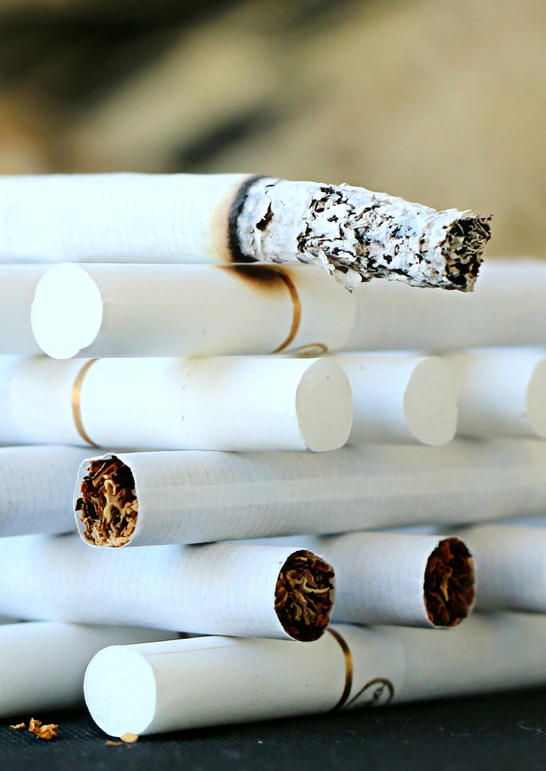
SDFGSG
Insert logo of your organization
here
DO NOT SMOKE
c DO NOT USE ANY FORM OF TOBACCO
Smoking is still the most important risk factor for cancer
#PrEvCan #CANCERCODE
The PrEvCan campaign was initiated by EONS and is run in association with key campaign partner, ESMO. More info: www.cancernurse.eu/prevcan

Slide 3
SDFGSG
Insert logo of your organization
here
DO NOT SMOKE
c DO NOT USE ANY FORM OF TOBACCO
Most e-cigarettes contain nicotine and are therefore addictive
#PrEvCan #CANCERCODE
The PrEvCan campaign was initiated by EONS and is run in association with key campaign partner, ESMO. More info: www.cancernurse.eu/prevcan

Slide 4
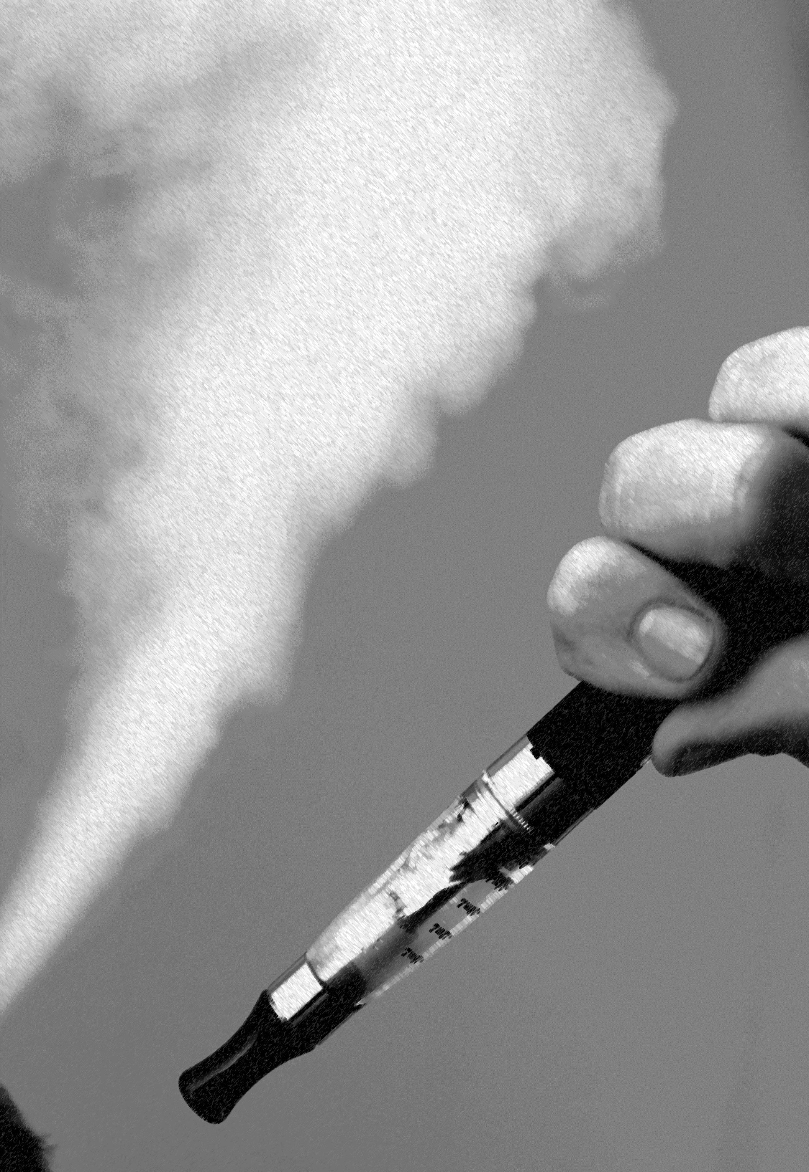
SDFGSG
Insert logo of your organization
here
DO NOT SMOKE
c DO NOT USE ANY FORM OF TOBACCO
The use of e-cigarettes is unsafe for kids, teens, and young adults
#PrEvCan #CANCERCODE
The PrEvCan campaign was initiated by EONS and is run in association with key campaign partner, ESMO. More info: www.cancernurse.eu/prevcan

Slide 5
SDFGSG
Insert logo of your organization
here
DO NOT SMOKE
c DO NOT USE ANY FORM OF TOBACCO
The use of water pipe is associated with lung cancer and other respiratory diseases
#PrEvCan #CANCERCODE
The PrEvCan campaign was initiated by EONS and is run in association with key campaign partner, ESMO. More info: www.cancernurse.eu/prevcan

Slide 6
SDFGSG
Insert logo of your organization
here
DO NOT SMOKE
c DO NOT USE ANY FORM OF TOBACCO
Never start using tobacco, you do yourself and the people around you a great favor
#PrEvCan #CANCERCODE
The PrEvCan campaign was initiated by EONS and is run in association with key campaign partner, ESMO. More info: www.cancernurse.eu/prevcan

Slide 7
SDFGSG
Insert logo of your organization
here
DO NOT SMOKE
c DO NOT USE ANY FORM OF TOBACCO
It is never too late to stop smoking
#PrEvCan #CANCERCODE
The PrEvCan campaign was initiated by EONS and is run in association with key campaign partner, ESMO. More info: www.cancernurse.eu/prevcan

Slide 8
SDFGSG
Insert logo of your organization
here
DO NOT SMOKE
c DO NOT USE ANY FORM OF TOBACCO
Quitting will improve your and your family's health
#PrEvCan #CANCERCODE
The PrEvCan campaign was initiated by EONS and is run in association with key campaign partner, ESMO. More info: www.cancernurse.eu/prevcan

Slide 9
SDFGSG
Insert logo of your organization
here
DO NOT SMOKE
c DO NOT USE ANY FORM OF TOBACCO
Ask a nurse or other health care professional for support
#PrEvCan #CANCERCODE
The PrEvCan campaign was initiated by EONS and is run in association with key campaign partner, ESMO. More info: www.cancernurse.eu/prevcan

Slide 10
SDFGSG
DO NOT SMOKE
c DO NOT USE ANY FORM OF TOBACCO
Messages for healthcare professionals
#PrEvCan #CANCERCODE
The PrEvCan campaign was initiated by EONS and is run in association with key campaign partner, ESMO. More info: www.cancernurse.eu/prevcan

Slide 11
SDFGSG
Insert logo of your organization
here
DO NOT SMOKE
c DO NOT USE ANY FORM OF TOBACCO
Smoking cessation is an essential part of primary, secondary and tertial cancer prevention
#PrEvCan #CANCERCODE
The PrEvCan campaign was initiated by EONS and is run in association with key campaign partner, ESMO. More info: www.cancernurse.eu/prevcan

Slide 12
SDFGSG
Insert logo of your organization
here
DO NOT SMOKE
c DO NOT USE ANY FORM OF TOBACCO
Always assess whether your patients are smoking. Offer advice, support and follow-up!
#PrEvCan #CANCERCODE
The PrEvCan campaign was initiated by EONS and is run in association with key campaign partner, ESMO. More info: www.cancernurse.eu/prevcan

Slide 13
SDFGSG
Insert logo of your organization
here
DO NOT SMOKE
c DO NOT USE ANY FORM OF TOBACCO
Refer to evidence based smoking cessation services
#PrEvCan #CANCERCODE
The PrEvCan campaign was initiated by EONS and is run in association with key campaign partner, ESMO. More info: www.cancernurse.eu/prevcan

Slide 14
SDFGSG
Insert logo of your organization
here
DO NOT SMOKE
c DO NOT USE ANY FORM OF TOBACCO
Pay extra attention to patients with co-occurring substance abuse
#PrEvCan #CANCERCODE
The PrEvCan campaign was initiated by EONS and is run in association with key campaign partner, ESMO. More info: www.cancernurse.eu/prevcan

Slide 15
SDFGSG
Insert logo of your organization
here
DO NOT SMOKE
c DO NOT USE ANY FORM OF TOBACCO
Customized message
Insert your photo
#PrEvCan #CANCERCODE
The PrEvCan campaign was initiated by EONS and is run in association with key campaign partner, ESMO. More info: www.cancernurse.eu/prevcan

